Slide 1


Magic Lamp

Slide 2

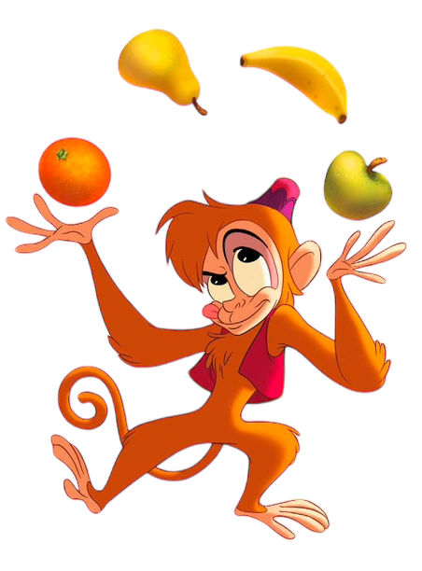

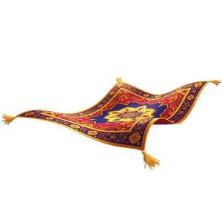
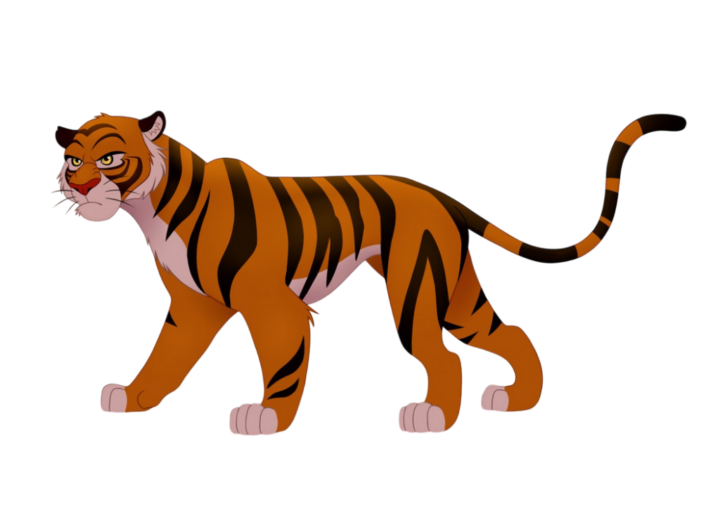
How to play
1
1 point
change points
+1 and
Choose again
-5 points

Slide 3
I wish I could...
1
3
2
1
2
fly
draw
swim
dance
run
3
4
2
4
sing
jump
walk
see
go
2
1
5
2
visit
hear
EAT
drink
sleep

Slide 4
I wish I could...
2
5
2
1
3
fly
draw
swim
dance
run
3
4
2
4
sing
jump
walk
see
go
3
2
3
hear
EAT
sleep
visit
drink

Slide 5
I wish I could...
3
3
2
4
fly
draw
swim
dance
run
3
4
1
2
sing
jump
walk
see
go
5
3
4
3
visit
hear
eat
drink
sleep

Slide 6

The End

