Slide 1



Teacher’s Notes
Students make a sentence to choose a balloon to pop, then win a prize
If a student gets a magic 8-ball prize, click on the question mark in the top left corner of a box of their choosing to “see the future”
Click the music box in the upper left corner of the slide to mute and unmute the background music (not every slide has music)
Music starts at first slide, then auto stops at 3rd slide. It will replay during each round (you can mute/unmute at any time with the music box button)

Slide 2







welcome to the
Balloon Pop
Balloon Pop
Darts game

Slide 3
How to Play
Make a sentence
to Pop a balloon
and see what prize you get!

Slide 4



How to Play
Stay standing
Choose again
sit down
see the future
Choose a balloon and see the prize behind it!

Slide 5


Round 1
Round 1

Slide 6







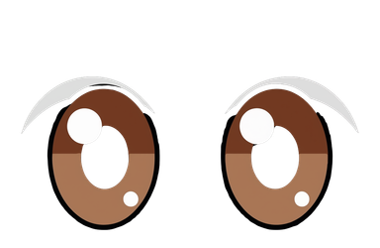





















she
he
they

Slide 7
Round 2
Round 2

Slide 8
she
he
they

Slide 9
Round 3
Round 3

Slide 10
she
he
they

Slide 11
Round 4
Round 4

Slide 12
she
he
they

Slide 13
Round 5
Round 5

Slide 14
she
he
they

Slide 15


we hope you had fun
Game Over

