Slide 1
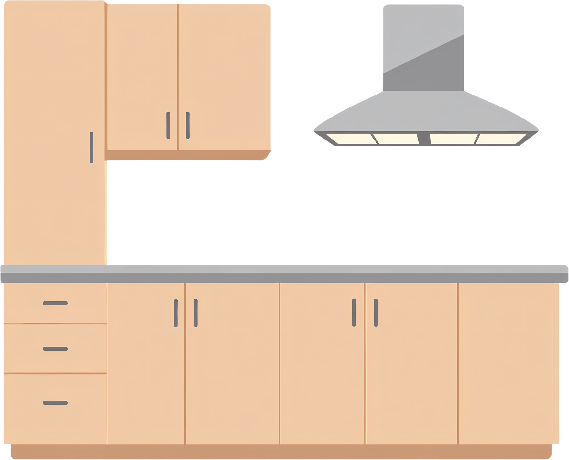


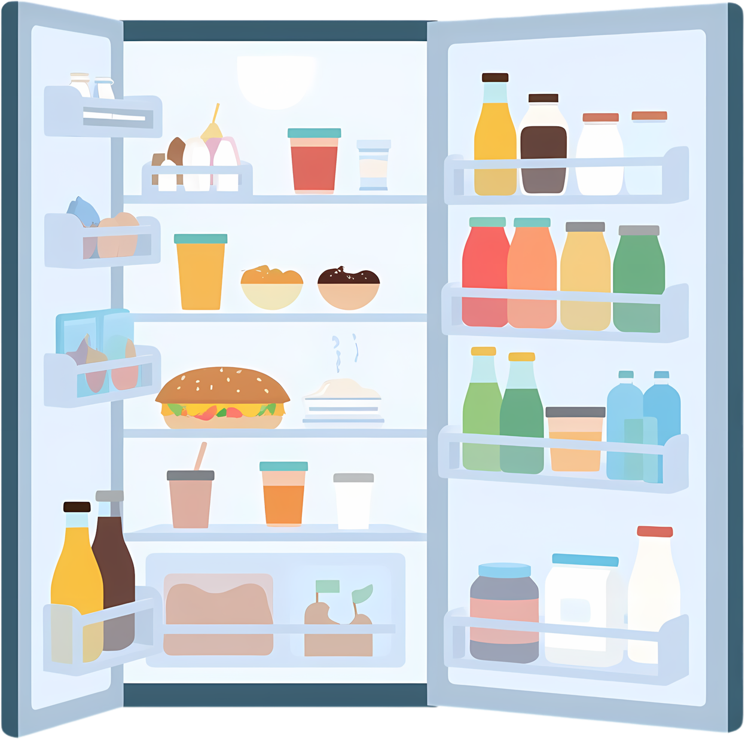



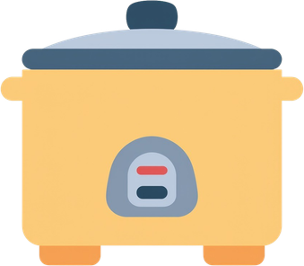






Cats in the kitchen

Slide 2
The cats have taken over the kitchen!

Slide 3
There are 5 cats.

Slide 4
Can you guess where they all are?

Slide 5
Pick a number to guess where a cat is.
1

Slide 6
if a cat is there, use
on, under, next to,
in front, behind
to make a sentence.

Slide 7
“The cat is on the stove”
+1 !

Slide 8









kitchen words
mixer
Rice cooker
stove
chair
microwave
pan
fridge
table
kettle
Hood
blender
mitt
clock
bottle
painting

Slide 9

Let’s play!

Slide 10
Round 1

Slide 11

1
2
7
4
5
6
10
3
8
9

Slide 12
Round 2

Slide 13
1
2
7
4
5
3
6
10
8
9

Slide 14
Round 3

Slide 15
2
4
5
3
6
7
1
10
8
9

Slide 16
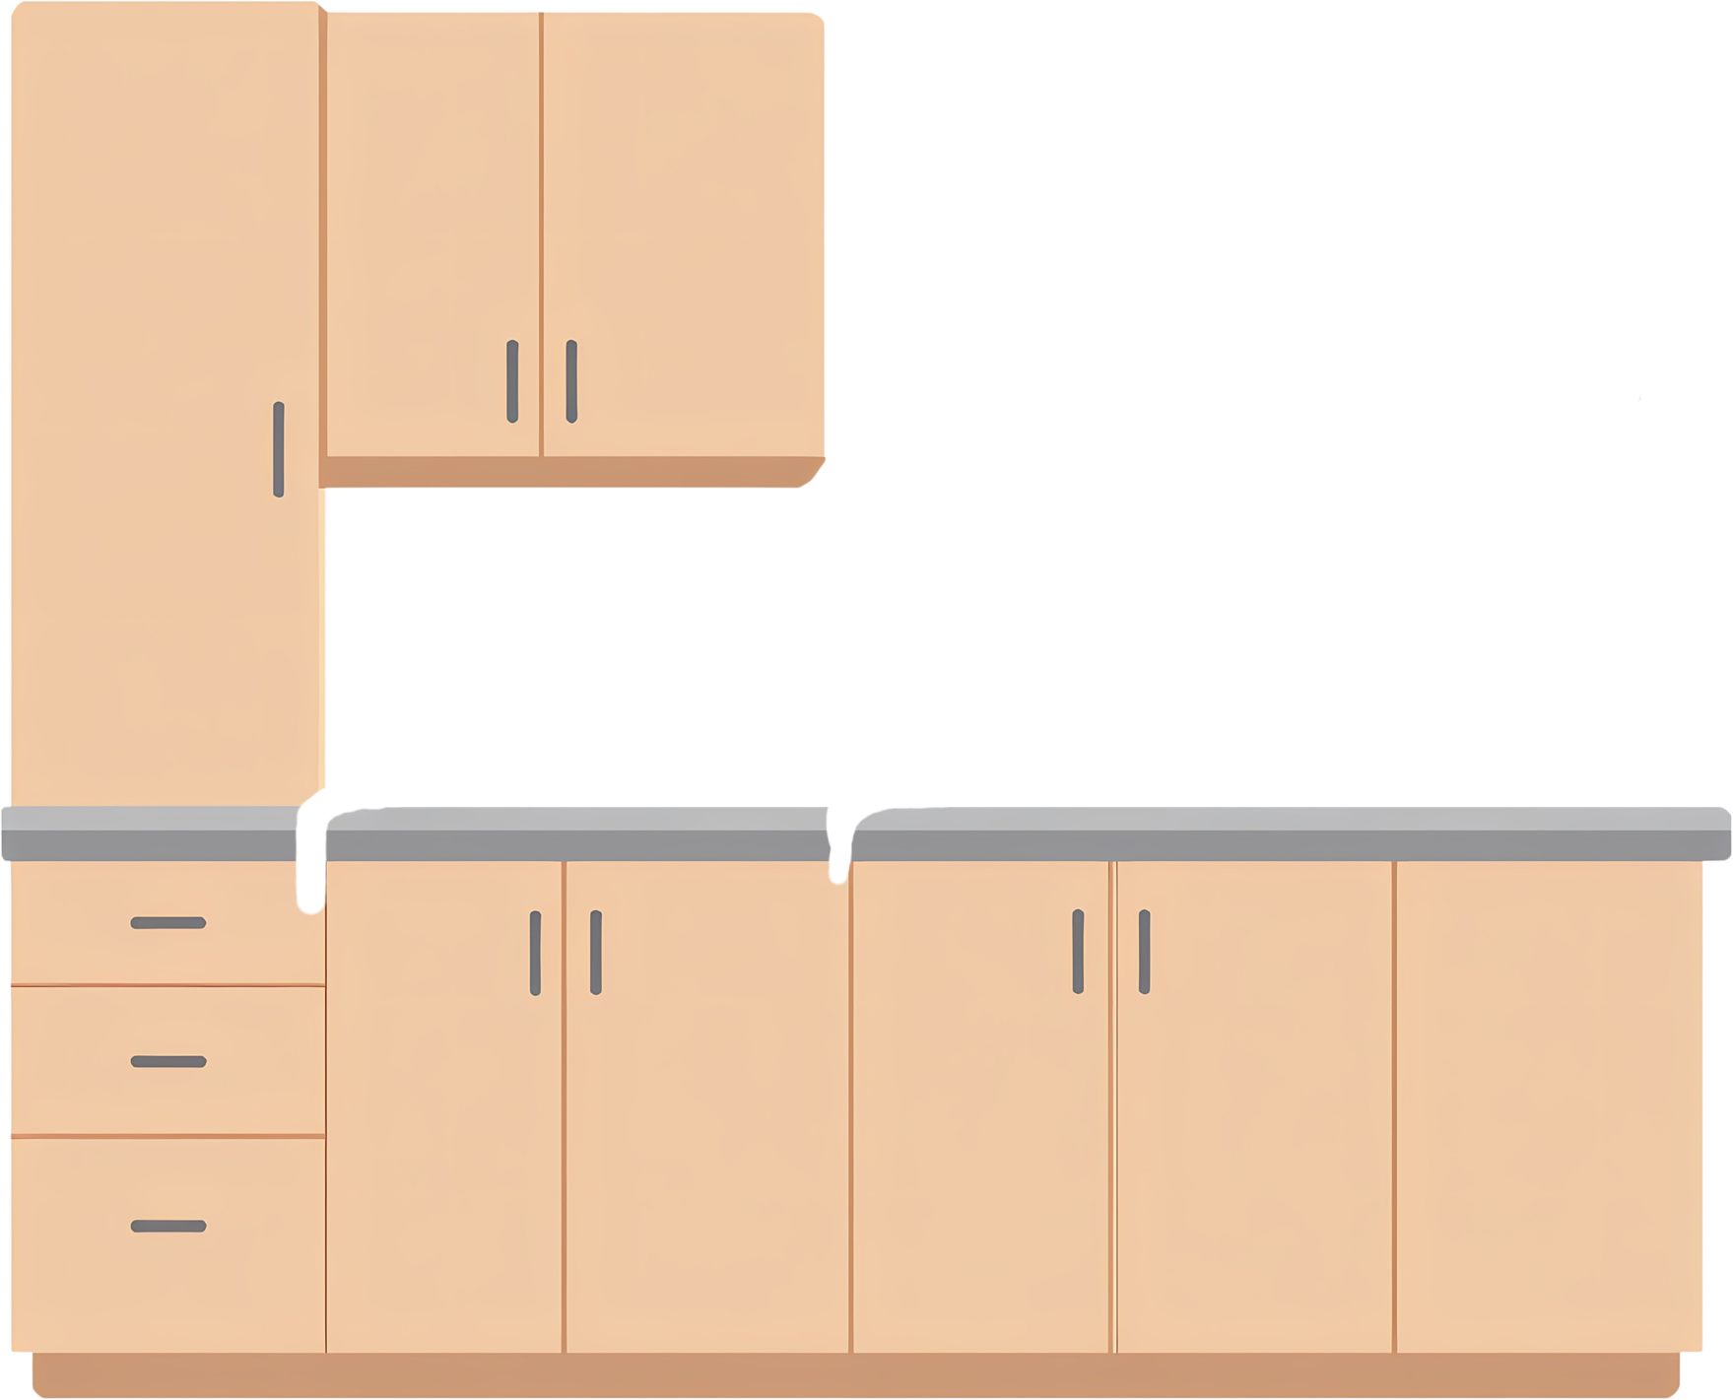
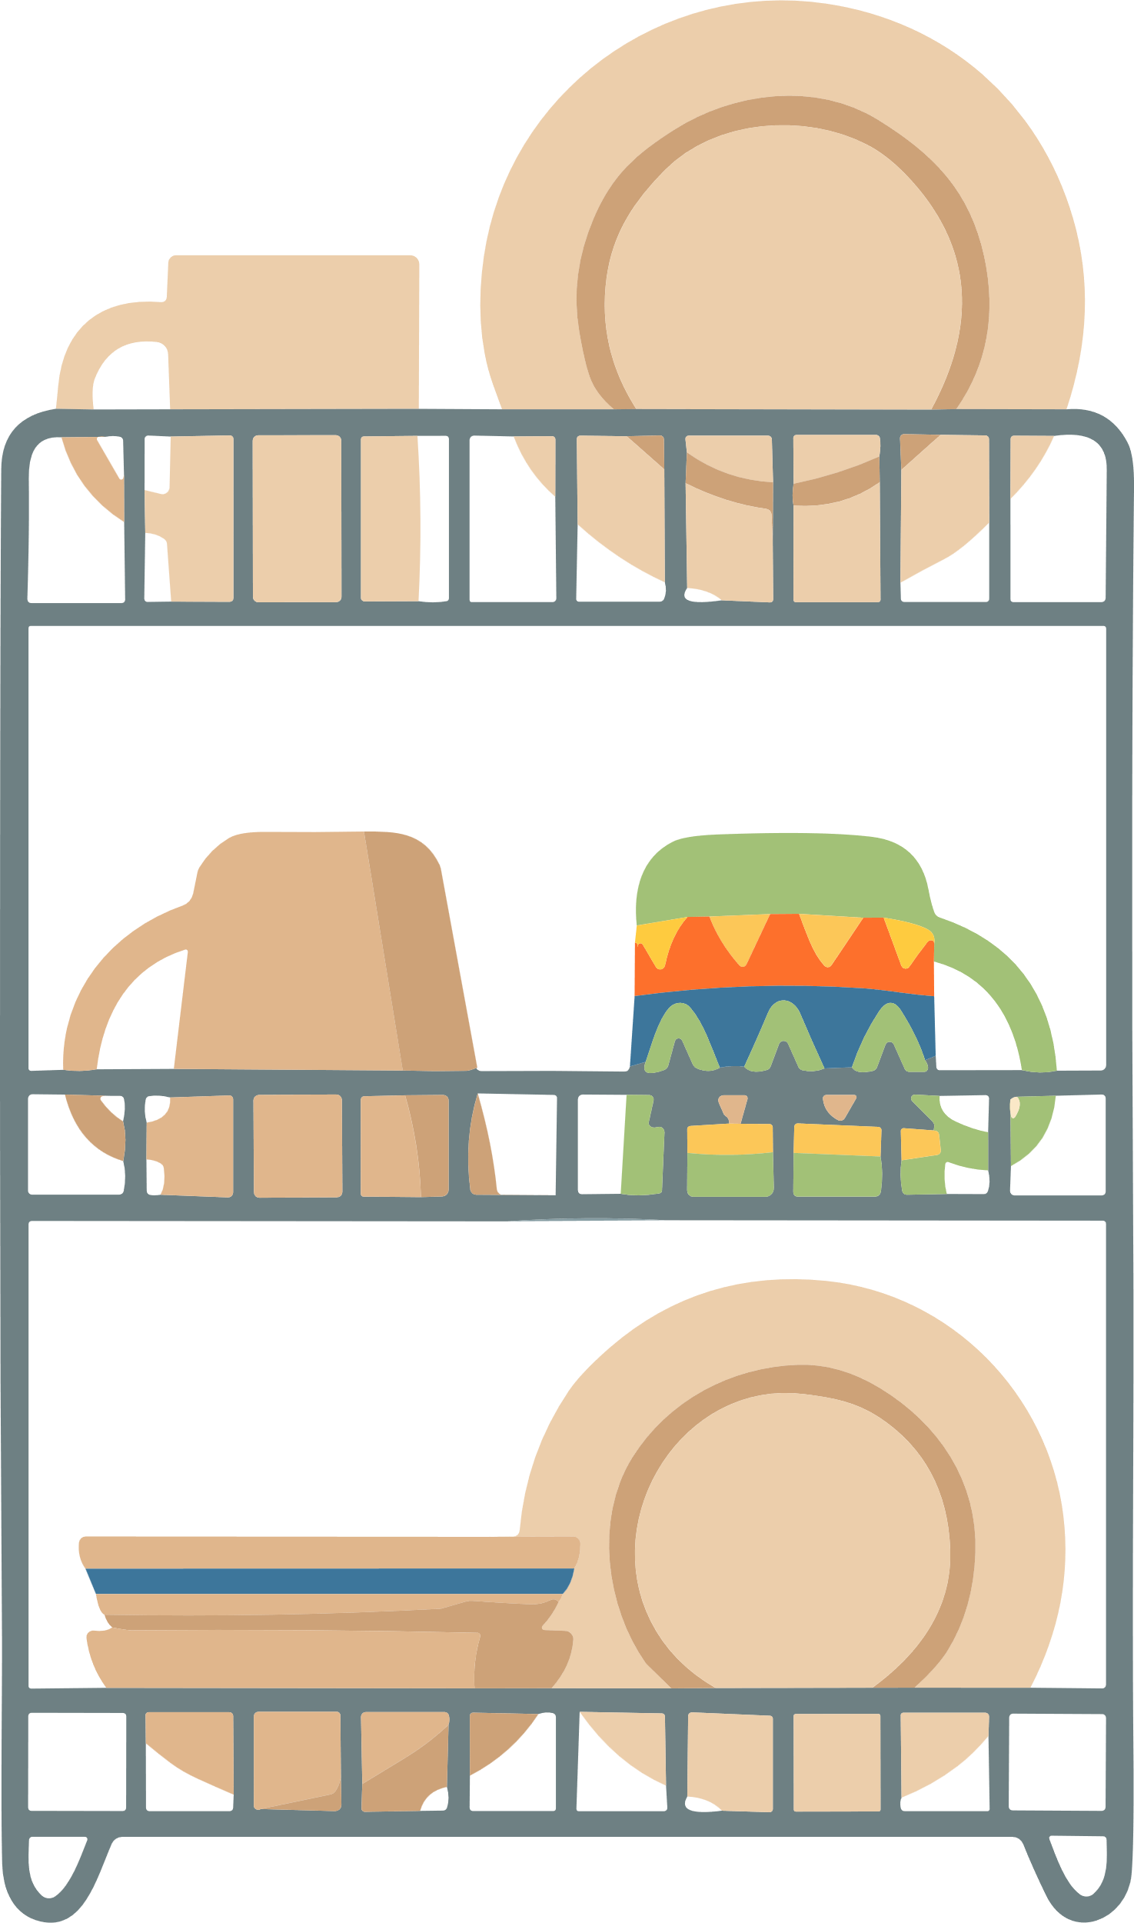
Round 4

Slide 17
2
4
10
5
7
1
3
6
8
9

Slide 18

Round 5

Slide 19
8
2
4
5
7
10
3
9
6
1

Slide 20

Round 6

Slide 21
6
2
3
9
8
10
1
7
4
5

Slide 22

Round 7

Slide 23
5
2
4
3
6
10
8
1
7
9

Slide 24
Round 8

Slide 25
2
7
6
8
4
10
1
9
3
5

Slide 26
Nice work!

