Slide 1

Teacher Instructions
There are 4 maps. Press “Skip town” when you finish one map to go to the next.
The red pin indicating current location will always start at the school. You can move the red pin by clicking on it, then clicking on one of the gray circles at each location on the map.
Students choose a place to “rob” and give directions to get there. The teacher then moves the red pin to the chosen location and clicks on the building to reveal the reward. Students should choose a place to go other than their current location.

Slide 2
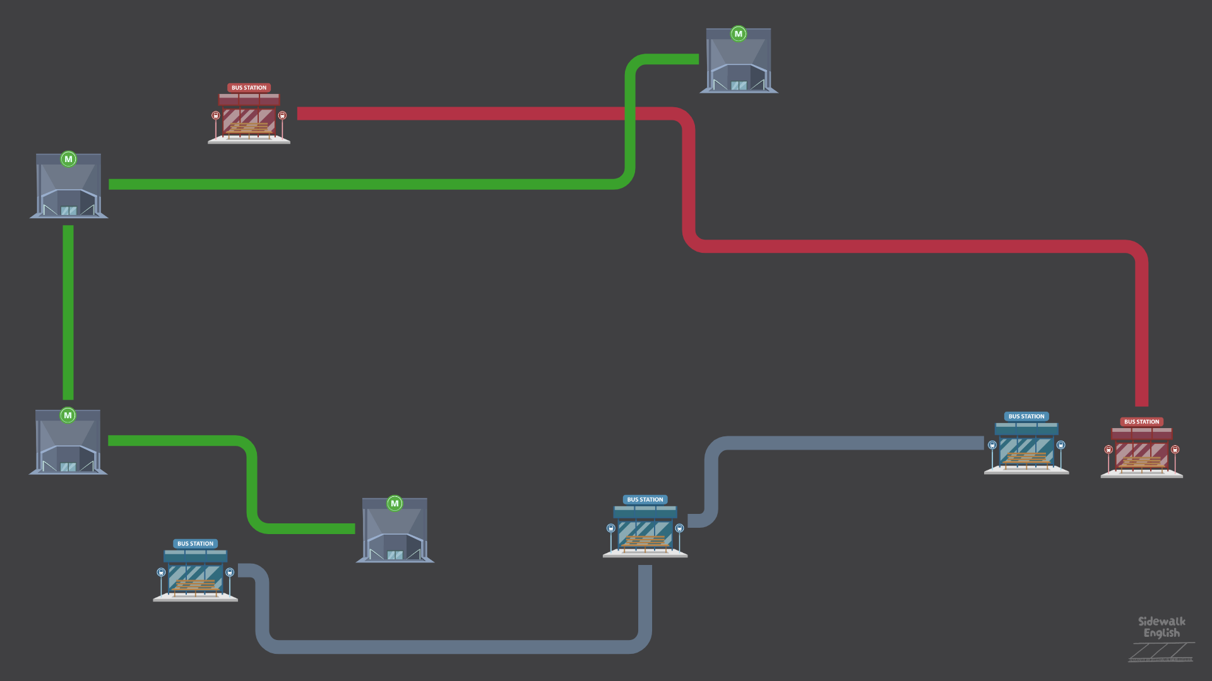

ON THE RUN

Slide 3

HOW TO PLAY
You’re a thief on the run!

Slide 4






HOW TO PLAY
Visit places around town and see how much money you can get.

Slide 5
HOW TO PLAY
1. Look at the map
2. Choose a place to go
3. Give directions to get there

Slide 6
PRACTICE

Slide 7
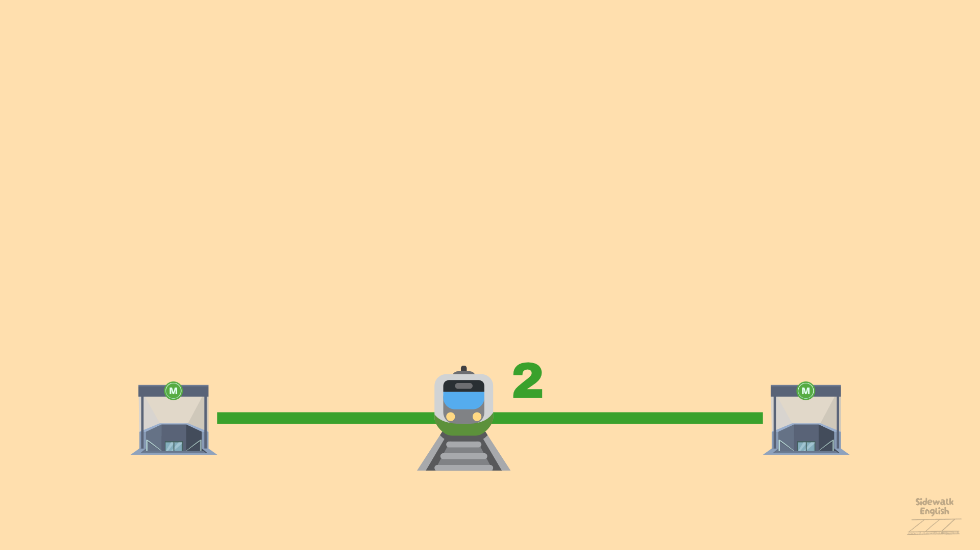
subway
“You can get there by __________”
line 2
“Take __________”

Slide 8
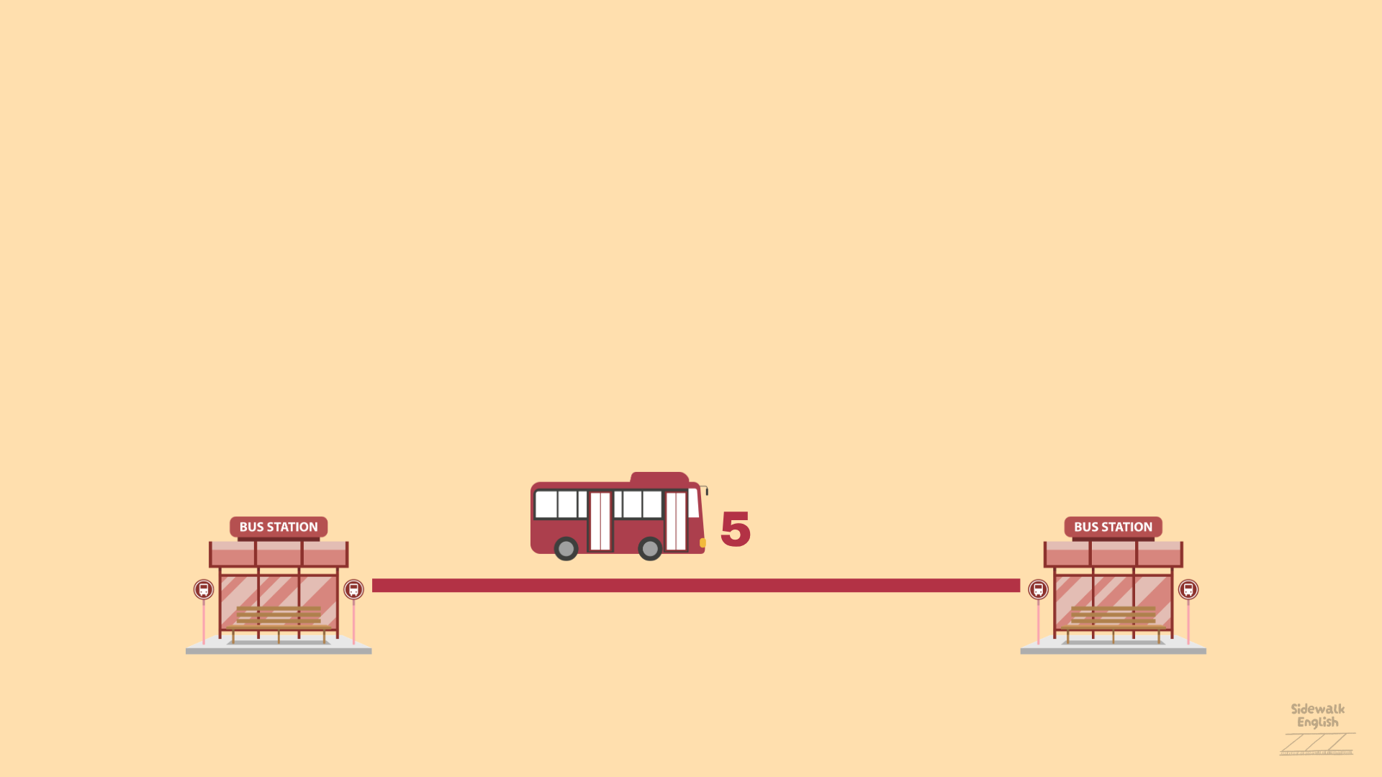
bus
“You can get there by __________”
bus number 5
“Take _______________”

Slide 9
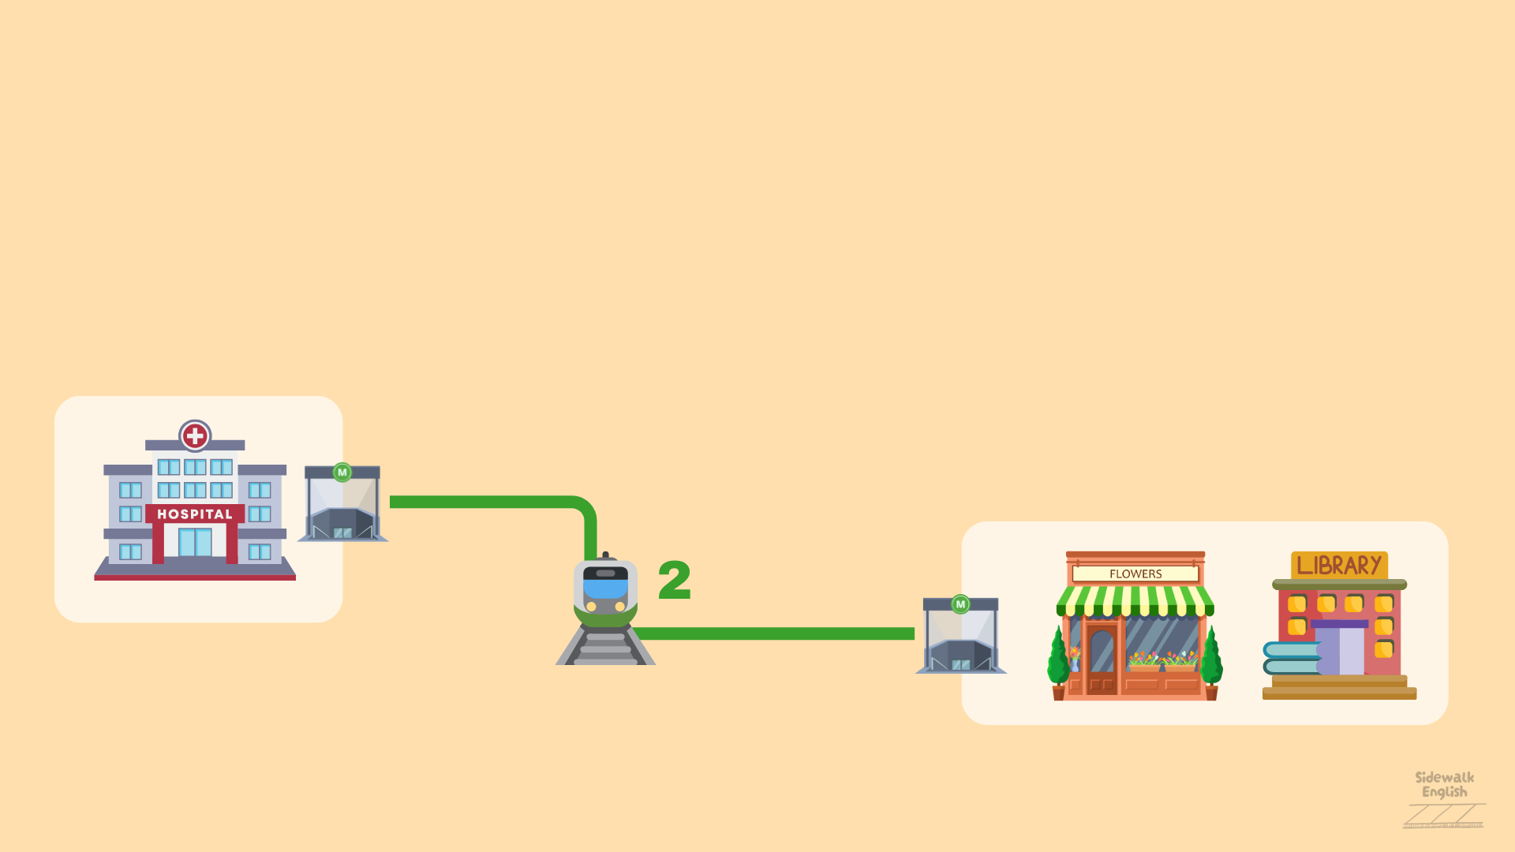

The red pin is your current location!

Slide 10
How can I get to the library?
subway
“You can get there by __________”
line 2
“Take __________”
Notes:
** Note: Have students answer the question, then move the red pin to the library to show how this works.
You can also have students use prepositional phrases when explaining how to move to another location. Example: “You can get there by subway. Take line 2. It’s next to the bookstore.” **

Slide 11
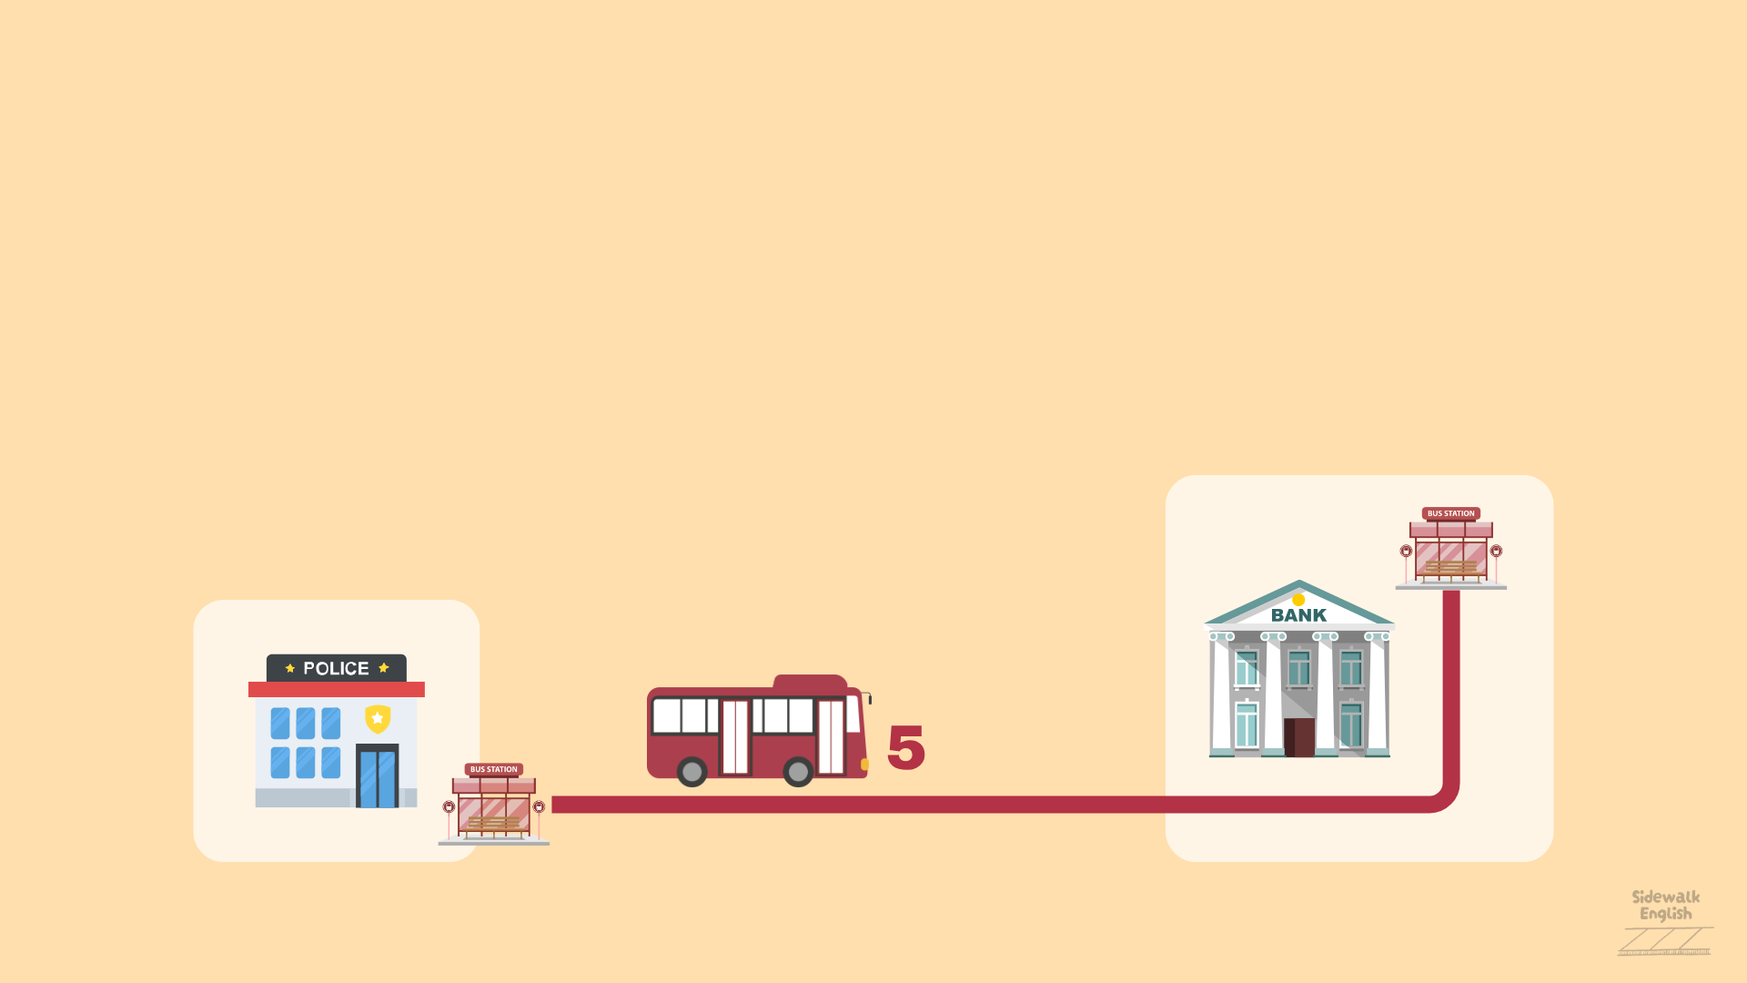
How can I get to the bank?
bus
“You can get there by __________”
bus number 5
“Take _______________”
Notes:
** Note: Have students answer the question, then move the red pin to the bank to show how this works.
You can also have students use prepositional phrases when explaining how to move to another location. Example: “You can get there by subway. Take line 2. It’s next to the bookstore.” **

Slide 12

Where is the library?
next to
“It’s ____________ the flower shop.”
Notes:
**Note: if students want to move to another location on the same block, they should use prepositional phrases “next to,” “behind,” “in front of” to explain where to go.**

Slide 13

Where is the school?
in front of
“It’s ____________ the bank.”
Notes:
**Note: if students want to move to another location on the same block, they should use prepositional phrases “next to,” “behind,” “in front of” to explain where to go.**

Slide 14
Where is the bank?
behind
“It’s ____________ the school.”
Notes:
**Note: if students want to move to another location on the same block, they should use prepositional phrases “next to,” “behind,” “in front of” to explain where to go.**

Slide 15
LET’S PLAY

Slide 16
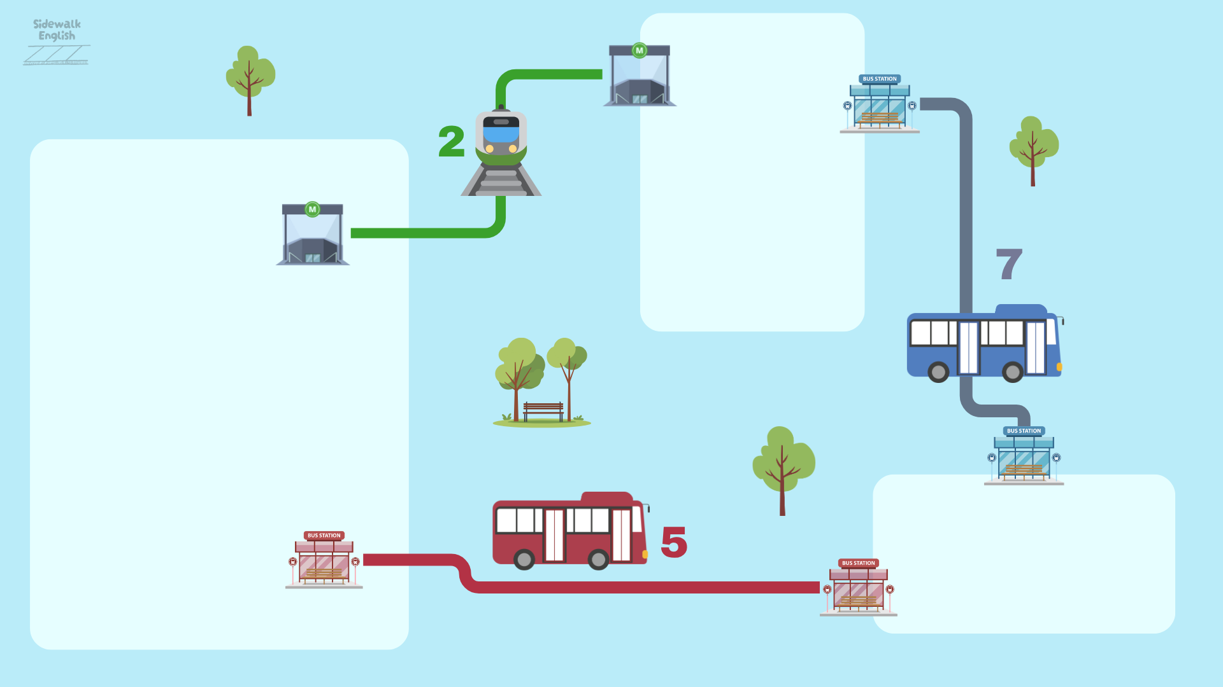



SKIP TOWN

Slide 17
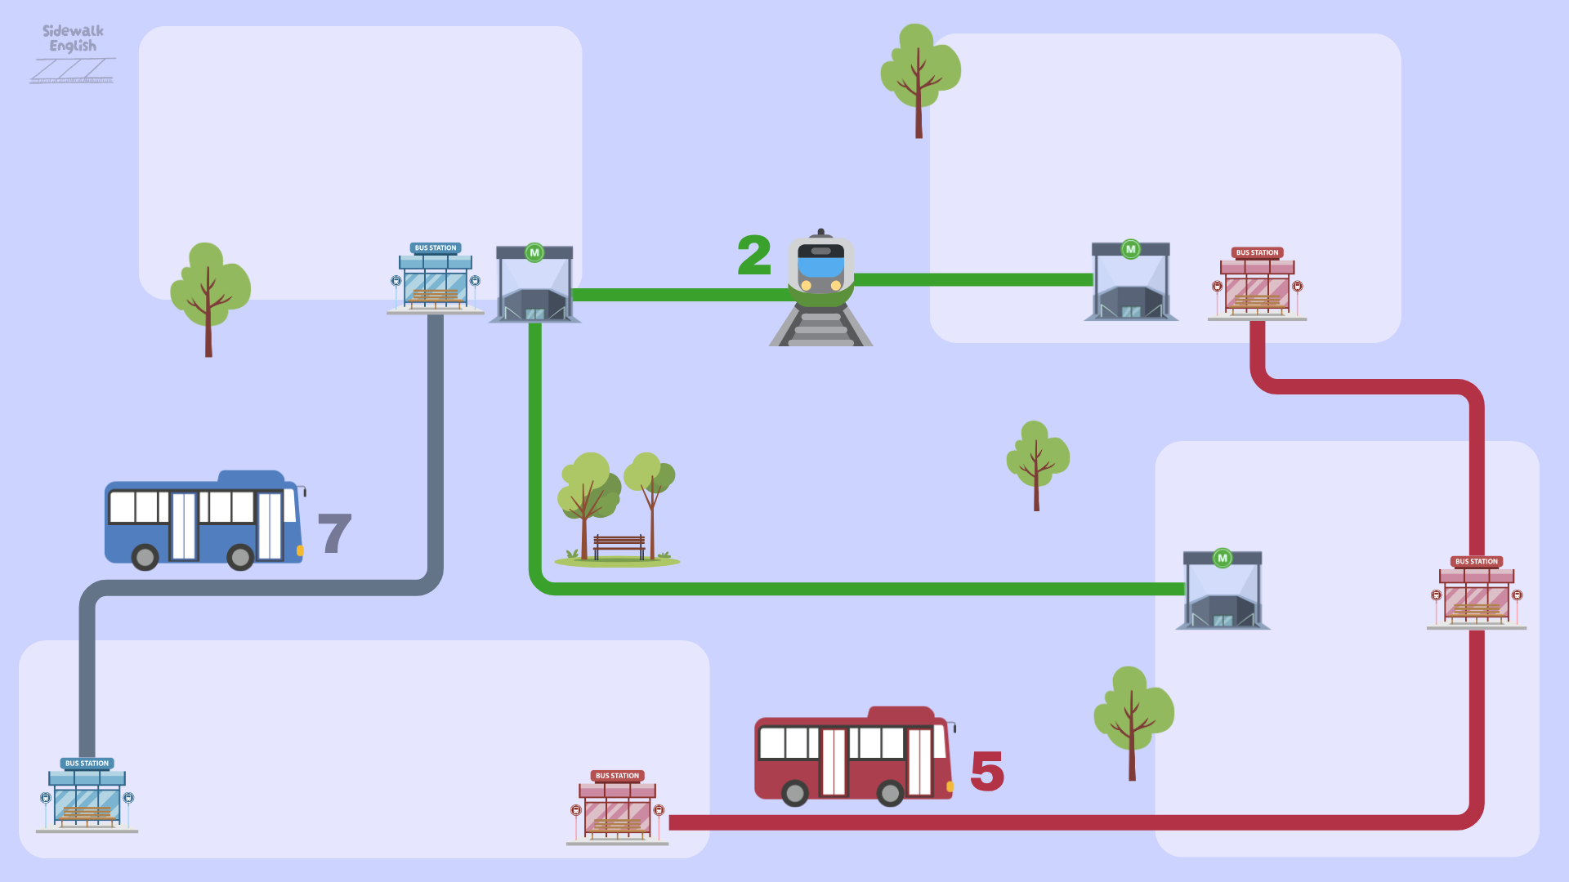
SKIP TOWN

Slide 18
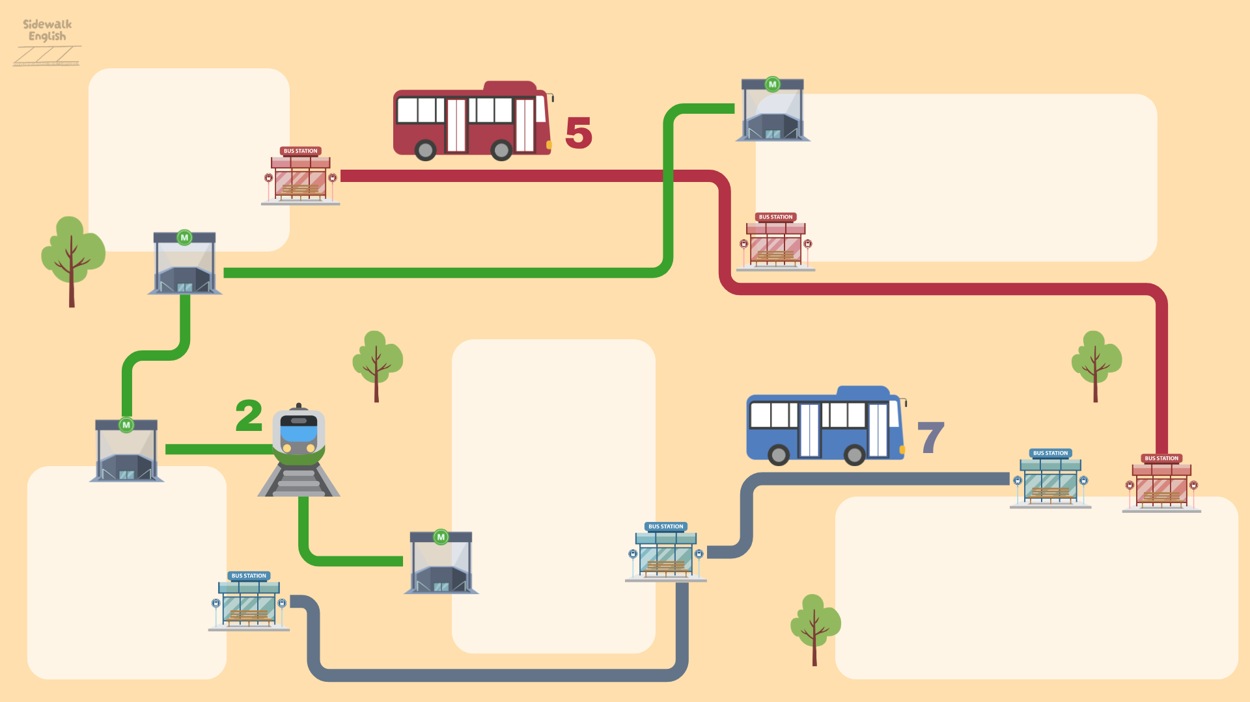
SKIP TOWN

Slide 19
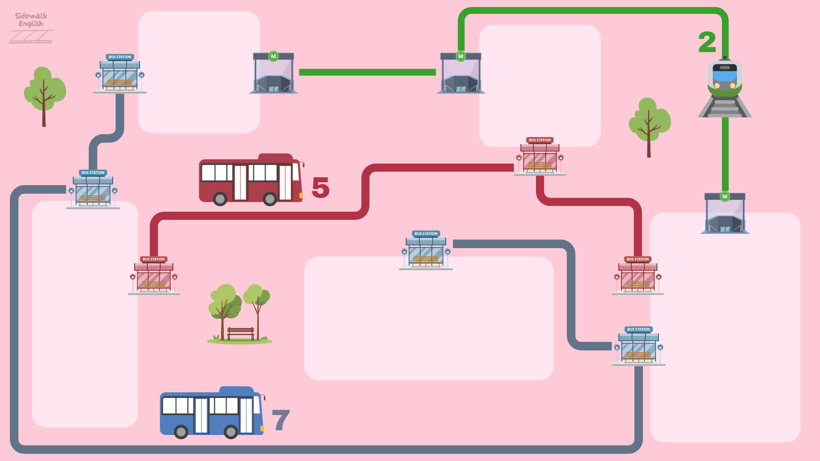
SKIP TOWN

Slide 20
The End

Slide 21




Slide 24


Slide 26


Slide 28


Slide 30


Slide 38


Slide 42


Slide 44


Slide 45
