Slide 1
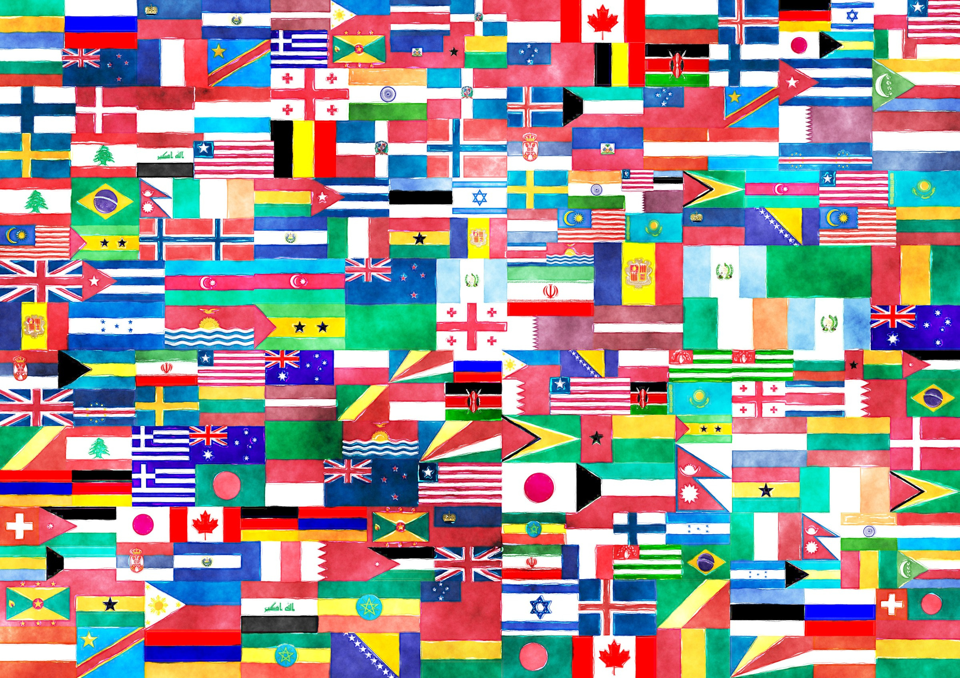
Country Spellcheck

Slide 2
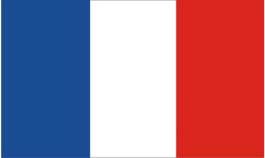
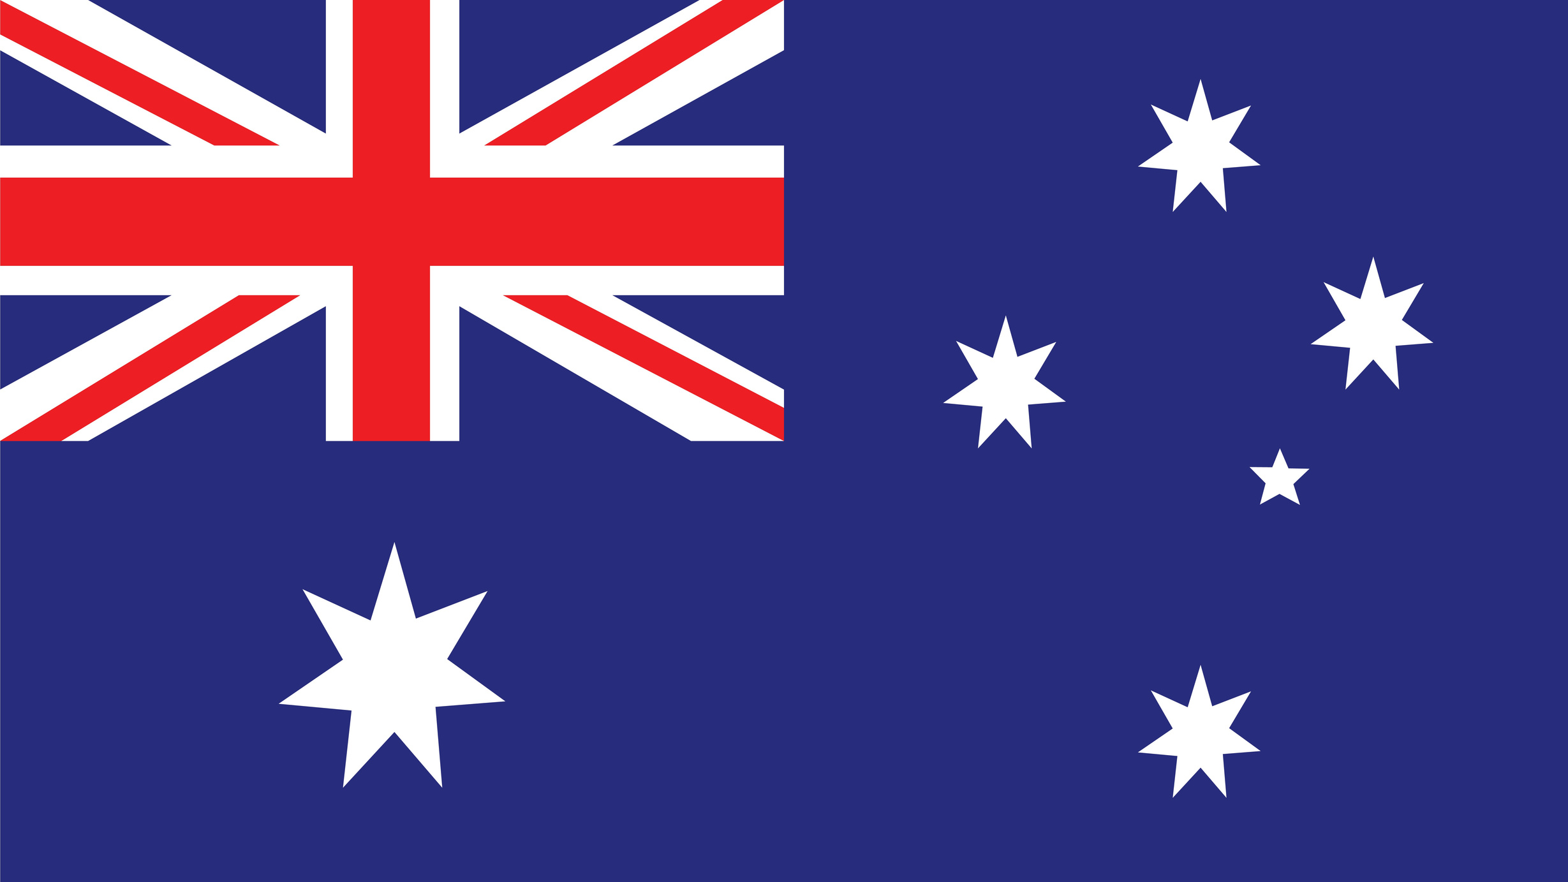
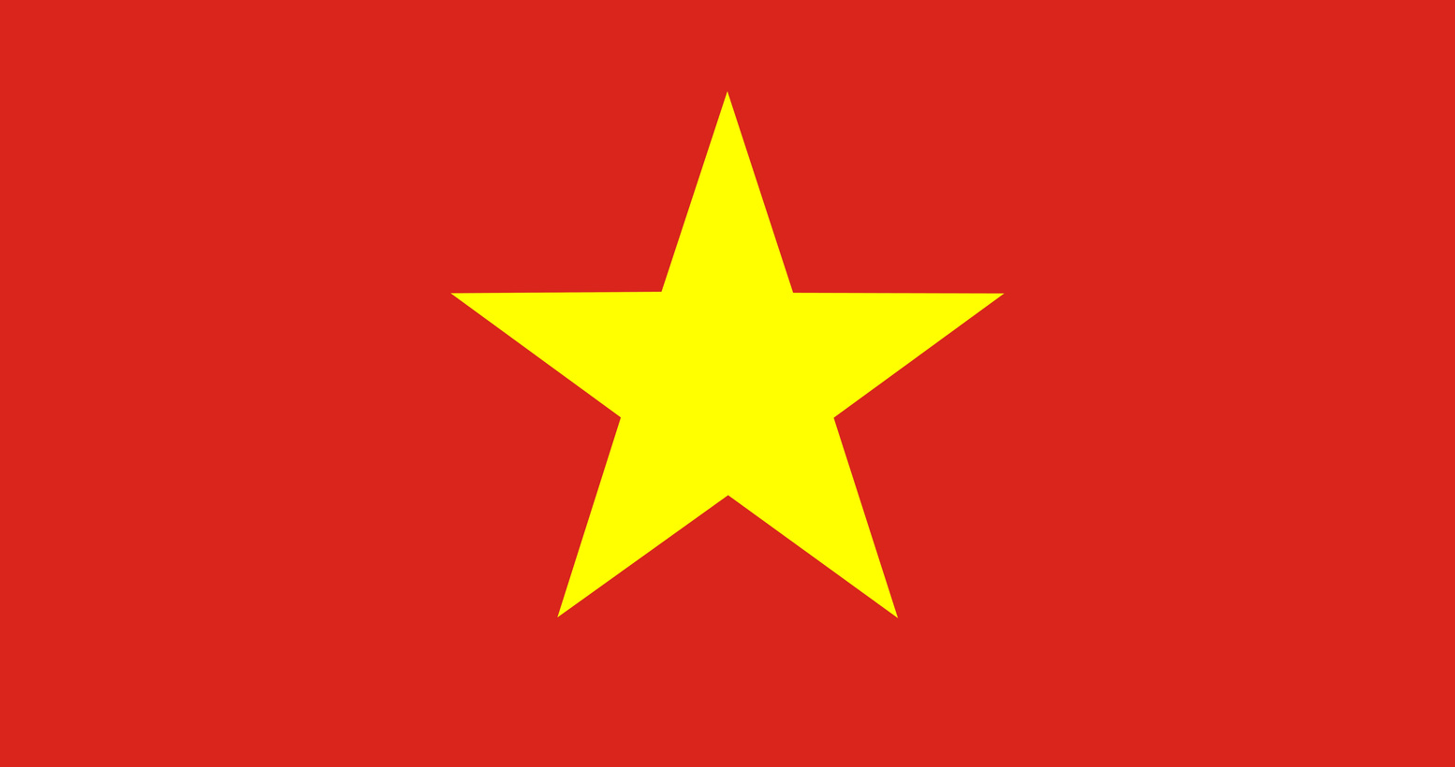
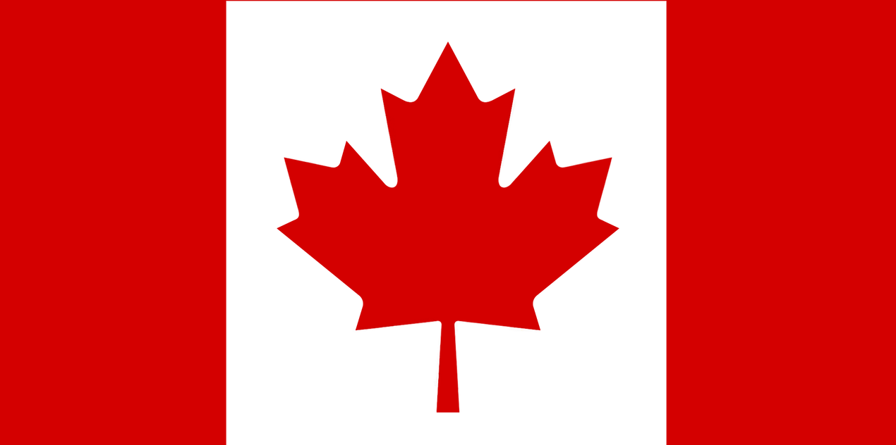




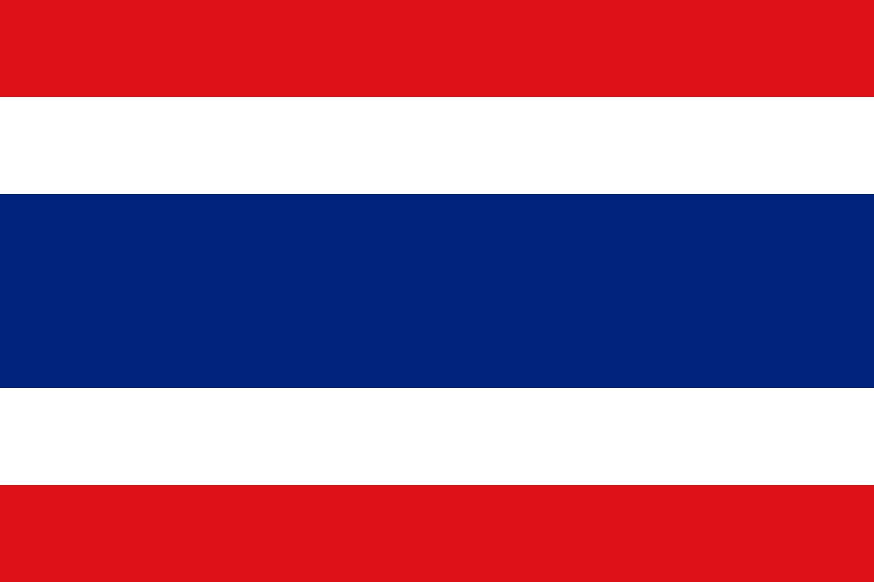

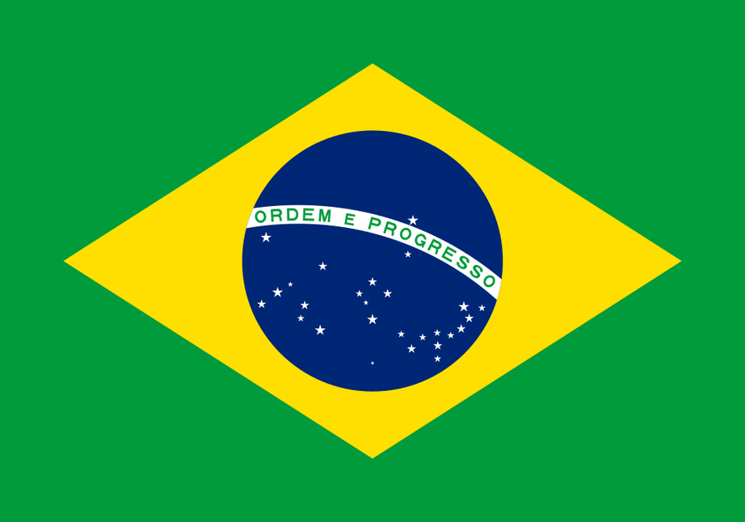
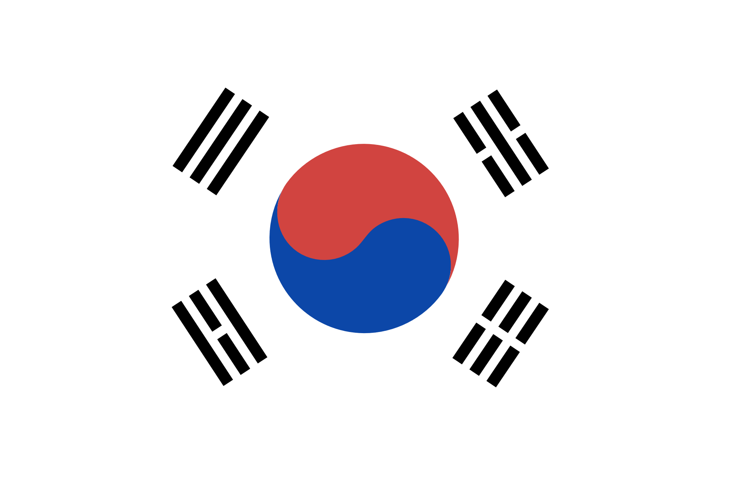
In English, write as many of these country names as you can in 3 minutes!

Slide 3
How do you spell ...
F
r
a
n
c
e

Slide 4
How do you spell ...
A
u
s
t
r
a
l
i
a

Slide 5
How do you spell ...
K
o
r
e
a

Slide 6
How do you spell ...
B
r
a
z
i
l

Slide 7
How do you spell ...
T
a
i
w
a
n

Slide 8
How do you spell ...
T
h
a
i
l
a
n
d

Slide 9

How do you spell ...
t
h
e
U.
S.

Slide 10
How do you spell ...
V
i
e
t
n
a
m

Slide 11
How do you spell ...
K
e
n
y
a

Slide 12
How do you spell ...
C
a
n
a
d
a

Slide 13
How do you spell ...
t
h
e
U.
K.

Slide 14
the U.K.
Taiwan
Korea
France
Canada
Brazil
Kenya
Thailand
Australia
Vietnam
the U.S.

