Slide 1


Sticky Sentences

Slide 2


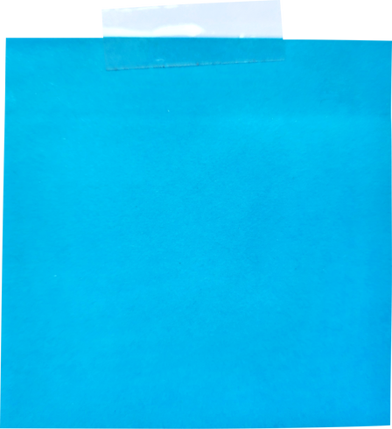
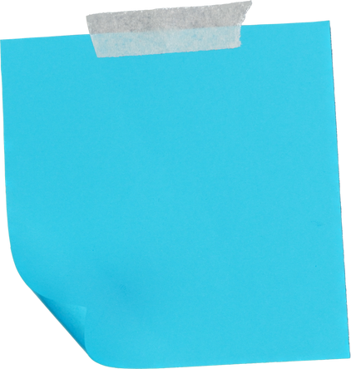
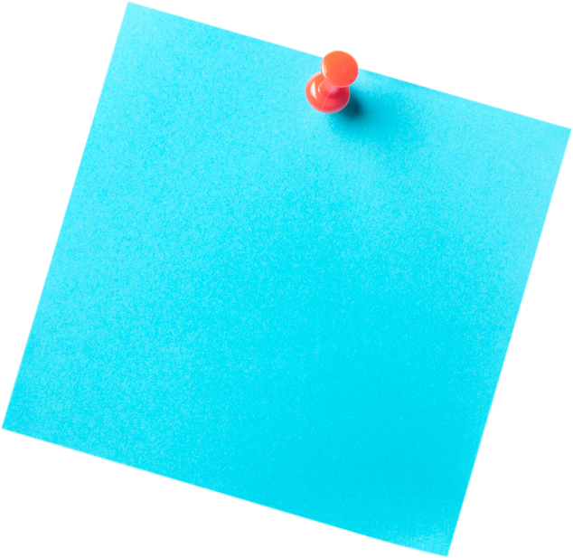
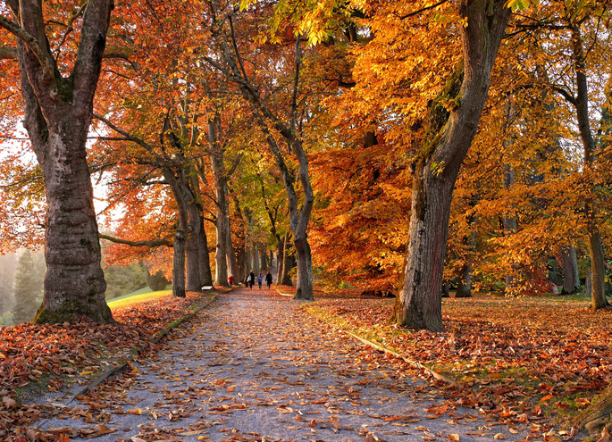

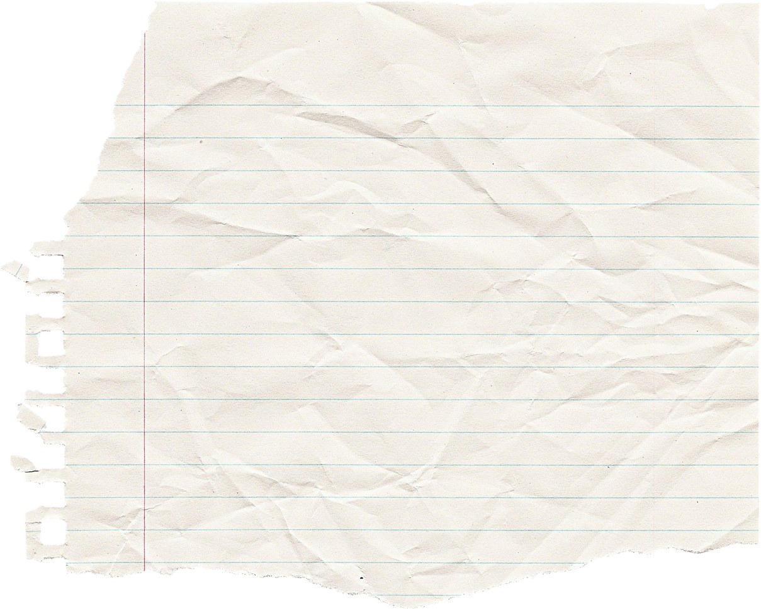
A
B
C
D
E
How to Play
  Say a letter and color to pick a sticky note
“B blue”

Slide 3
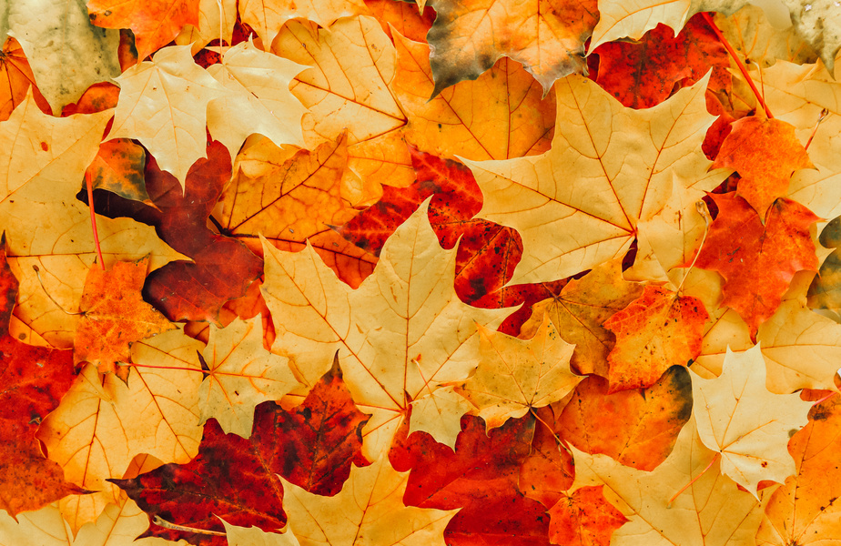
A
B
C
D
E
How to Play
2. Find the 2 hidden pictures.
“E blue”
“D blue”

Slide 4
A
B
C
D
E
How to Play
3. Make a sentence using both pictures.
“I like fall because there are colorful leaves.”

Slide 5
A
B
C
D
E
1
2
How to Play
Points = remaining sticky notes
2 points

Slide 6
A
B
C
D
E
1
2
How to Play
Team 1 members will take turns choosing until they can make a sentence.
Then team 2 will go.

Slide 7



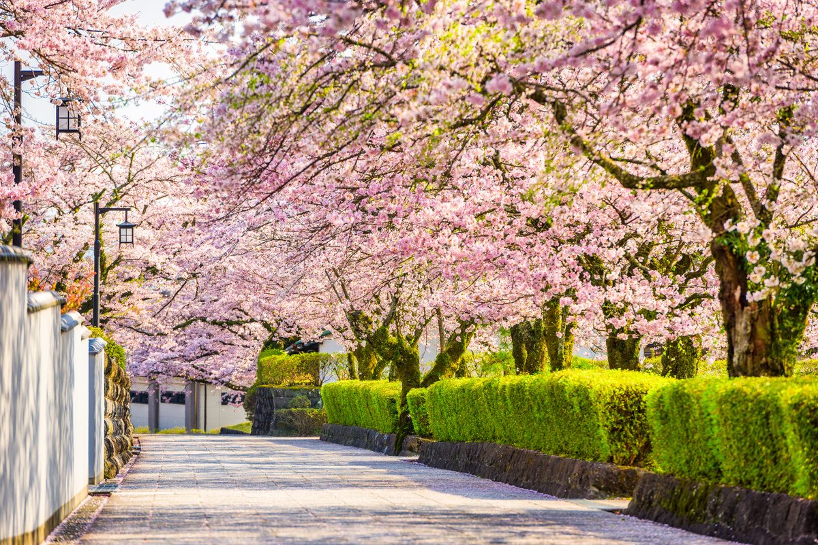
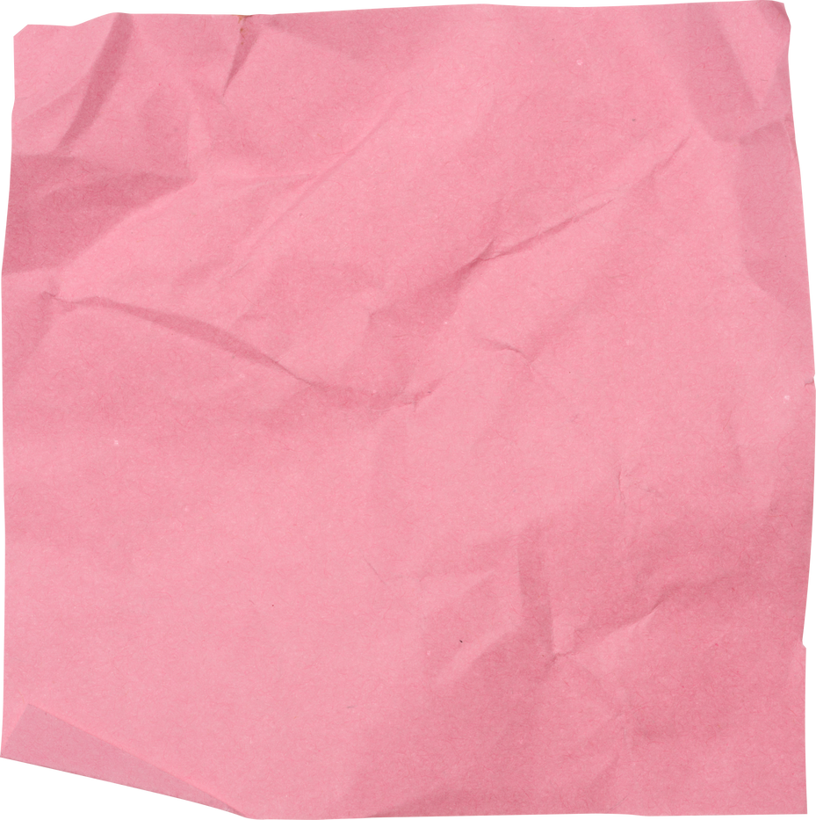
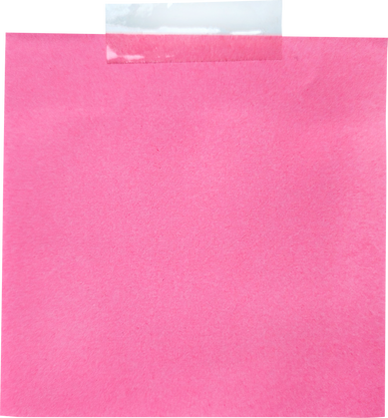
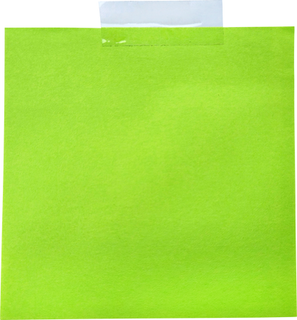

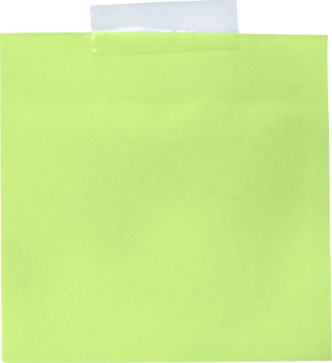


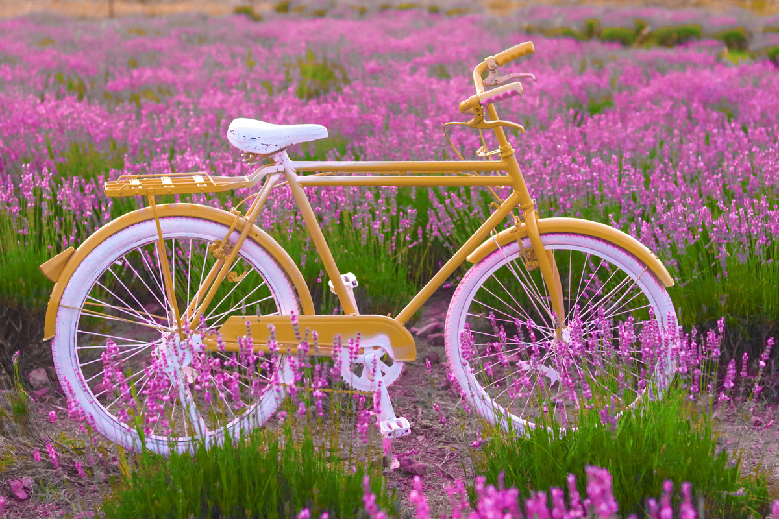
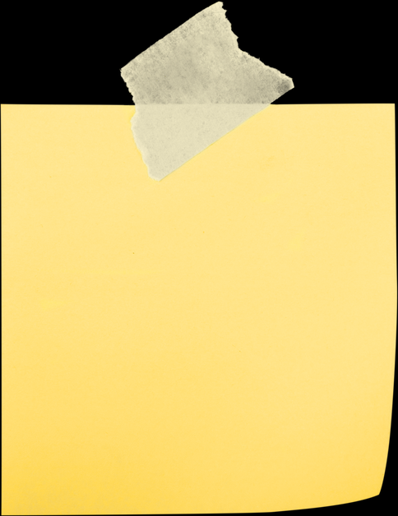

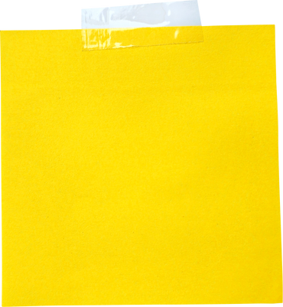
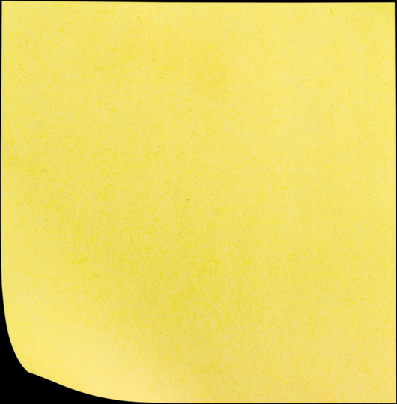


A
B
C
D
E

Slide 8

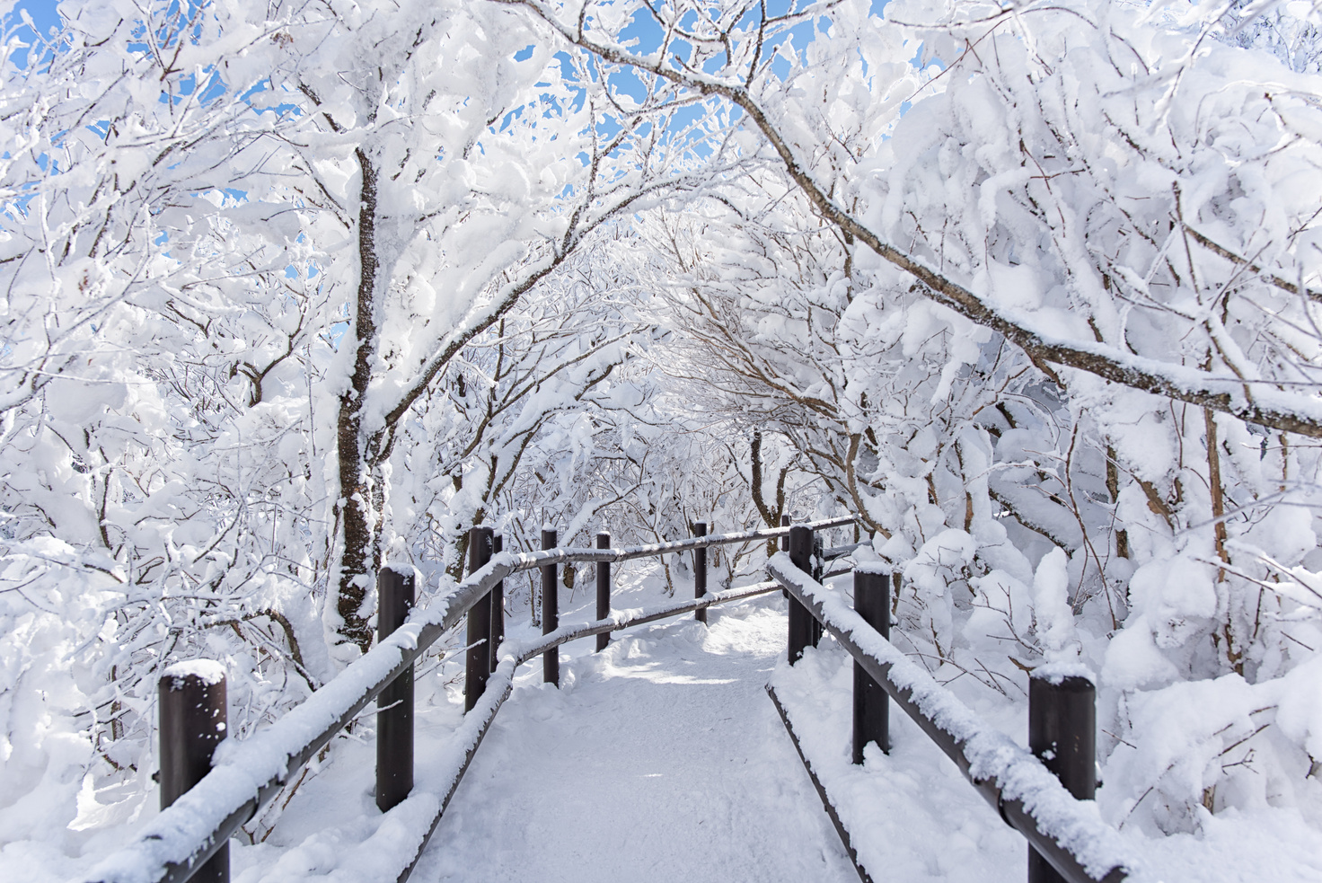

A
B
C
D
E

Slide 9
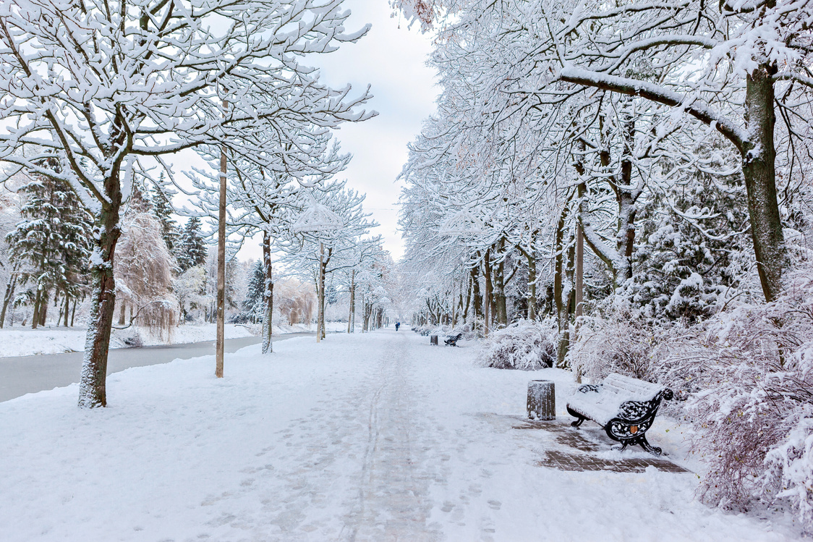
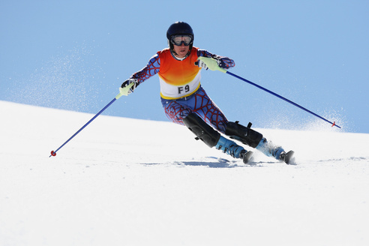
A
B
C
D
E

Slide 10
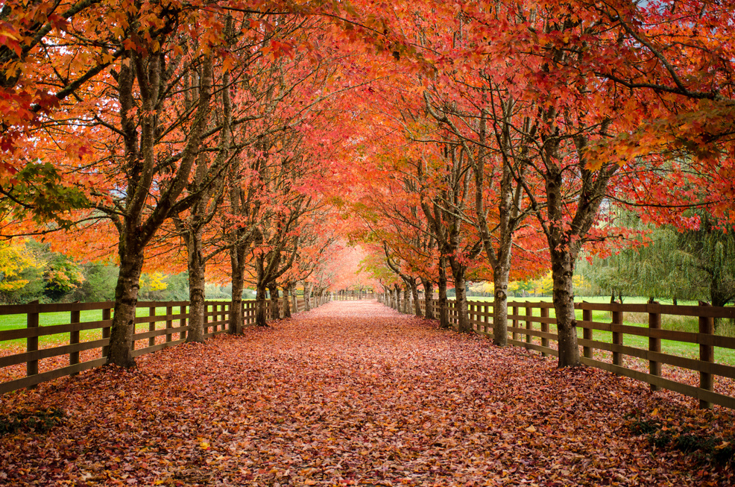

A
B
C
D
E

Slide 11
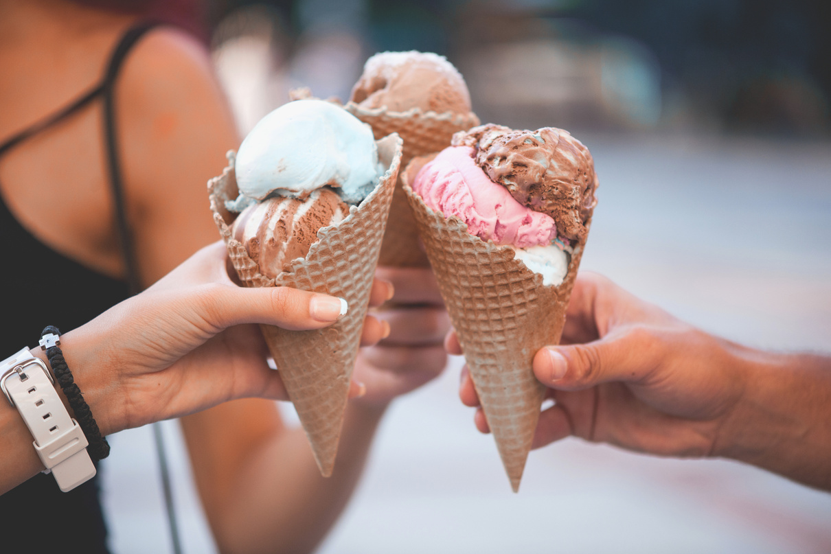

A
B
C
D
E

Slide 12
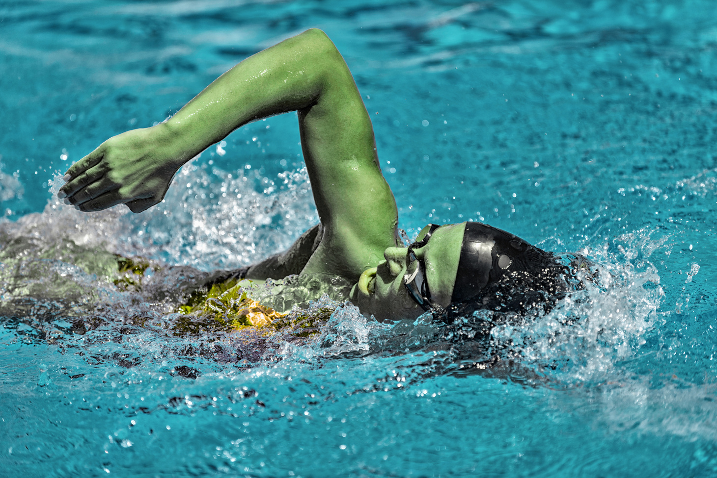
A
B
C
D
E

Slide 13
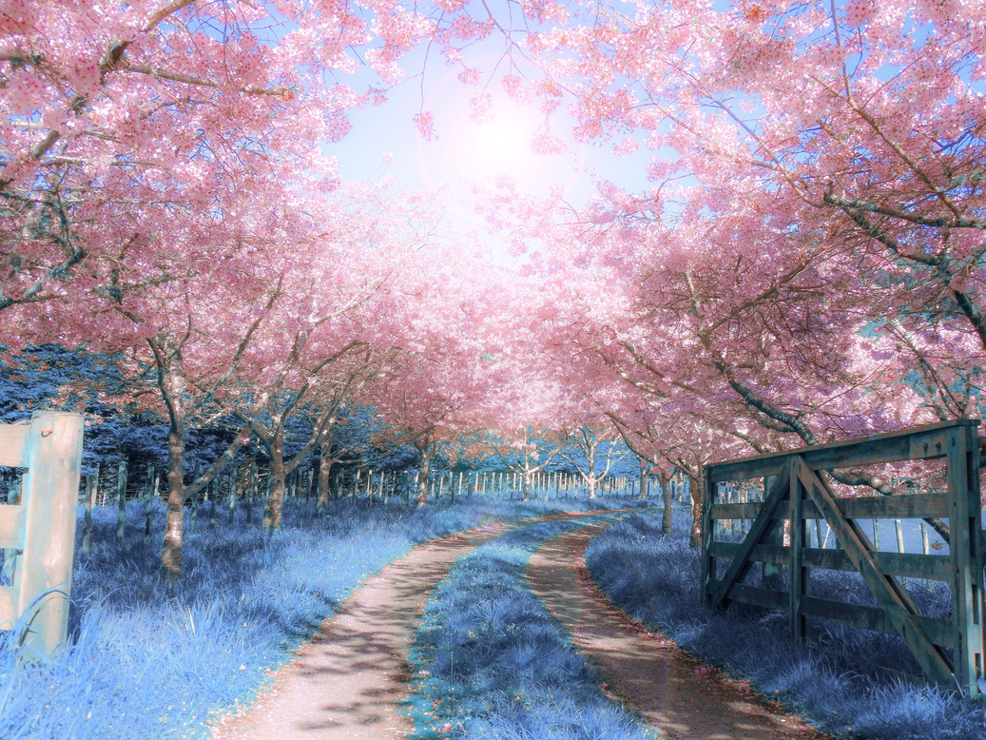
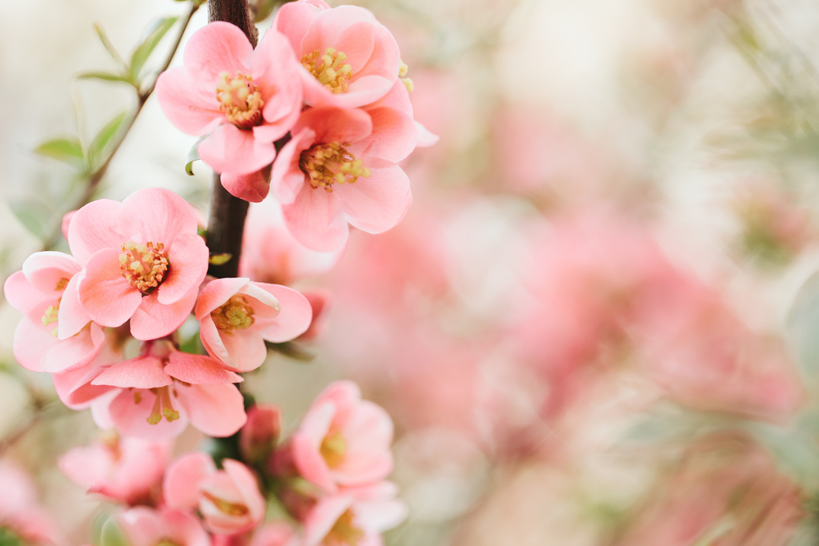
A
B
C
D
E

Slide 14
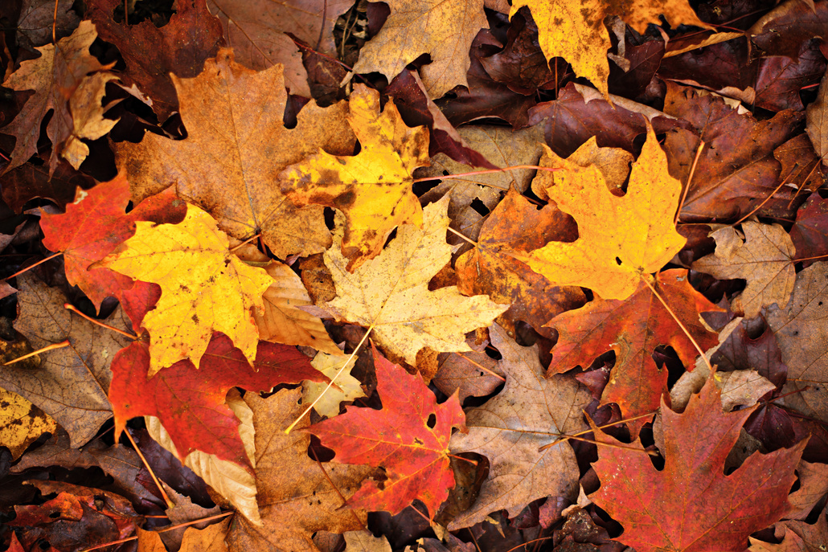
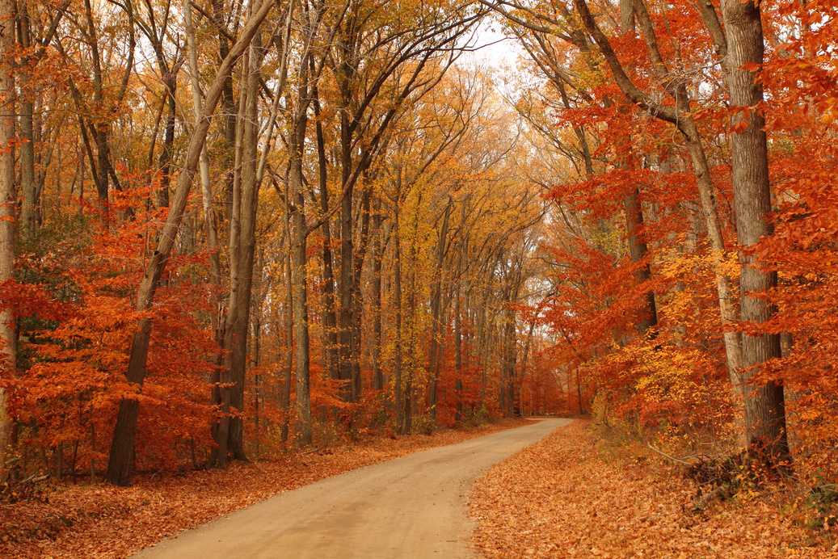
A
B
C
D
E

Slide 15


Bonus Round
Double points!
one picture

Slide 16

A
B
C
D
E

Slide 17
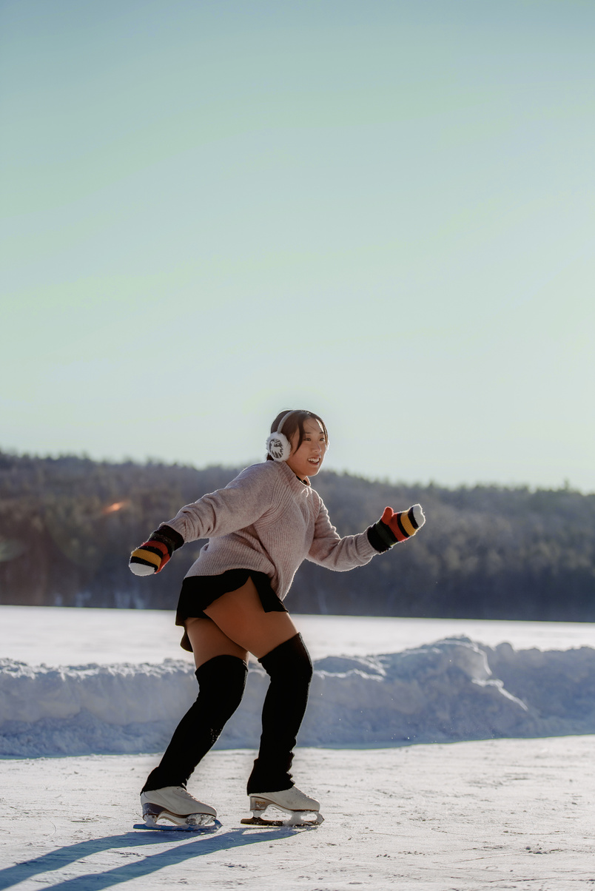
A
B
C
D
E

Slide 18
Good Job!

