Slide 1


Battle Ninjas
Speaking Game

Slide 2

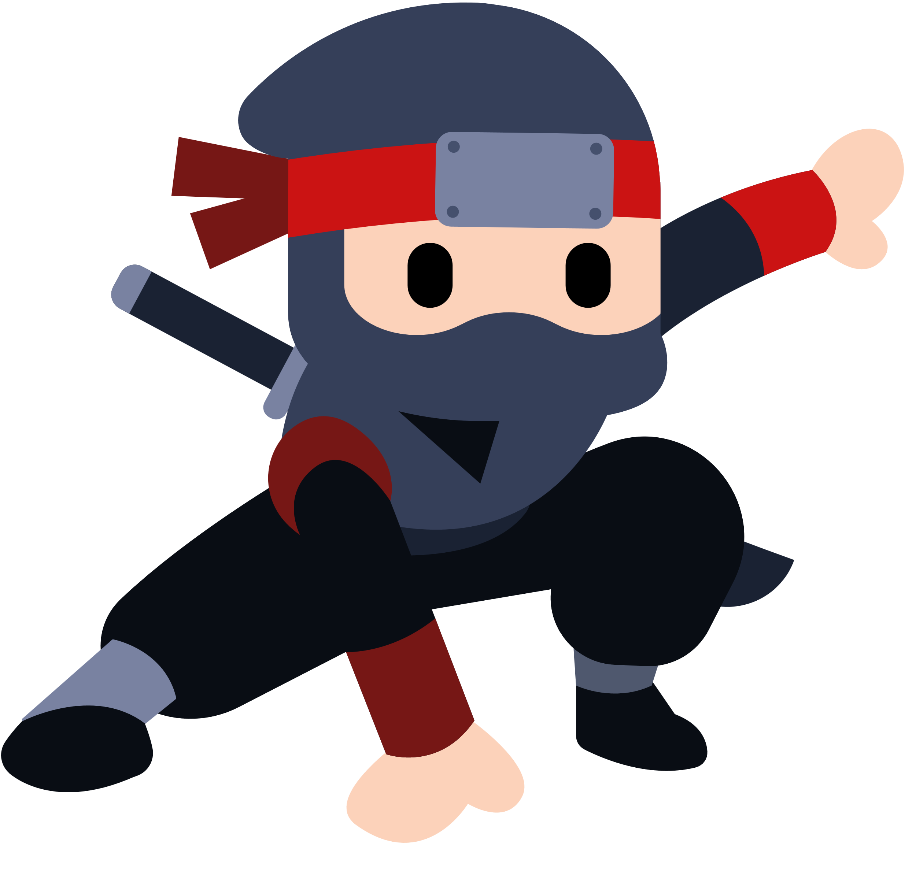
Key Expressions
kitchen
Q. What’s in the __________?
stove
A. There is a _________.

Slide 3
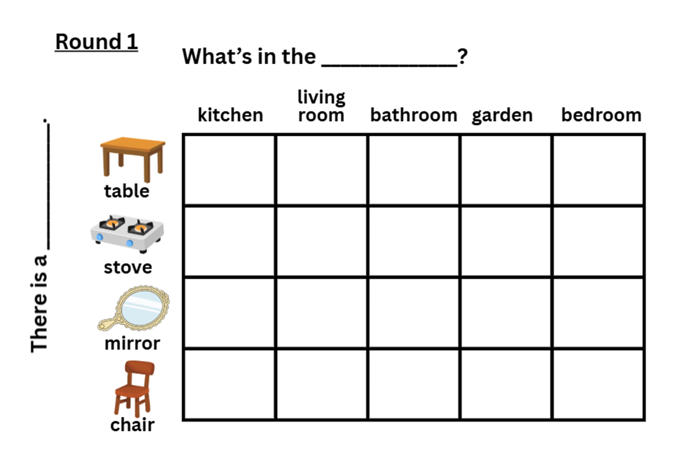

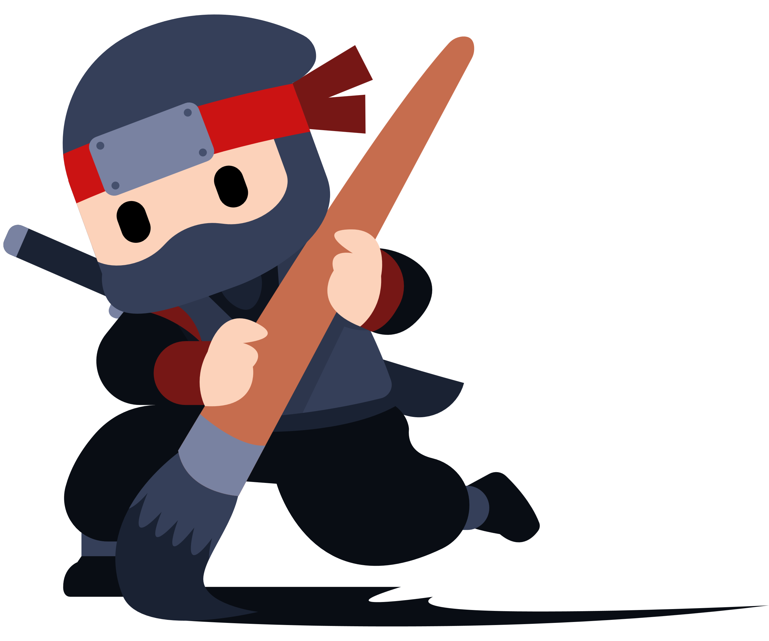
Draw 8 ninjas!

Slide 4
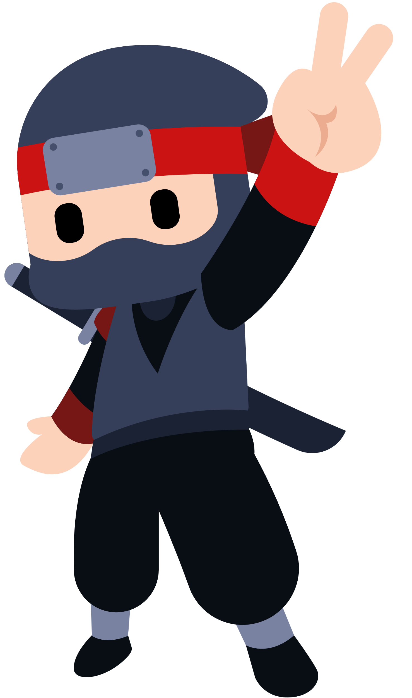
How to play
The teacher will randomly choose 2 students.

Slide 5
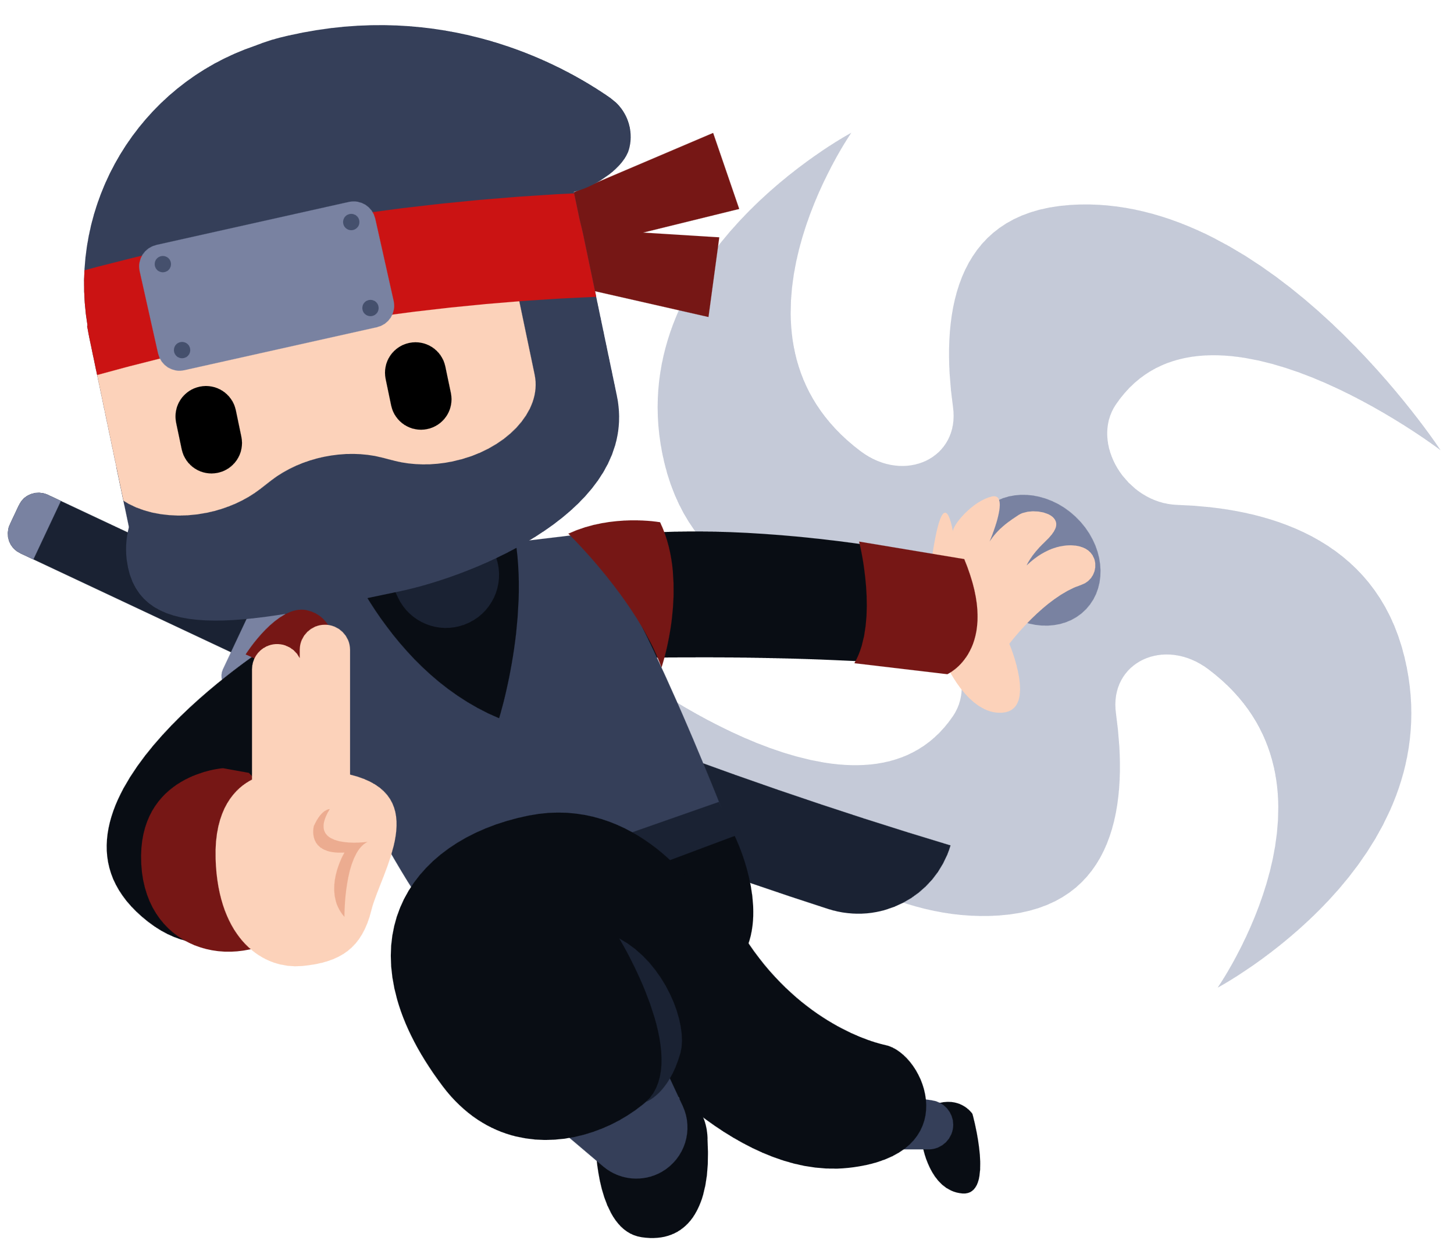
How to play
Student A will ask:
Q. What’s in the __________?

Slide 6
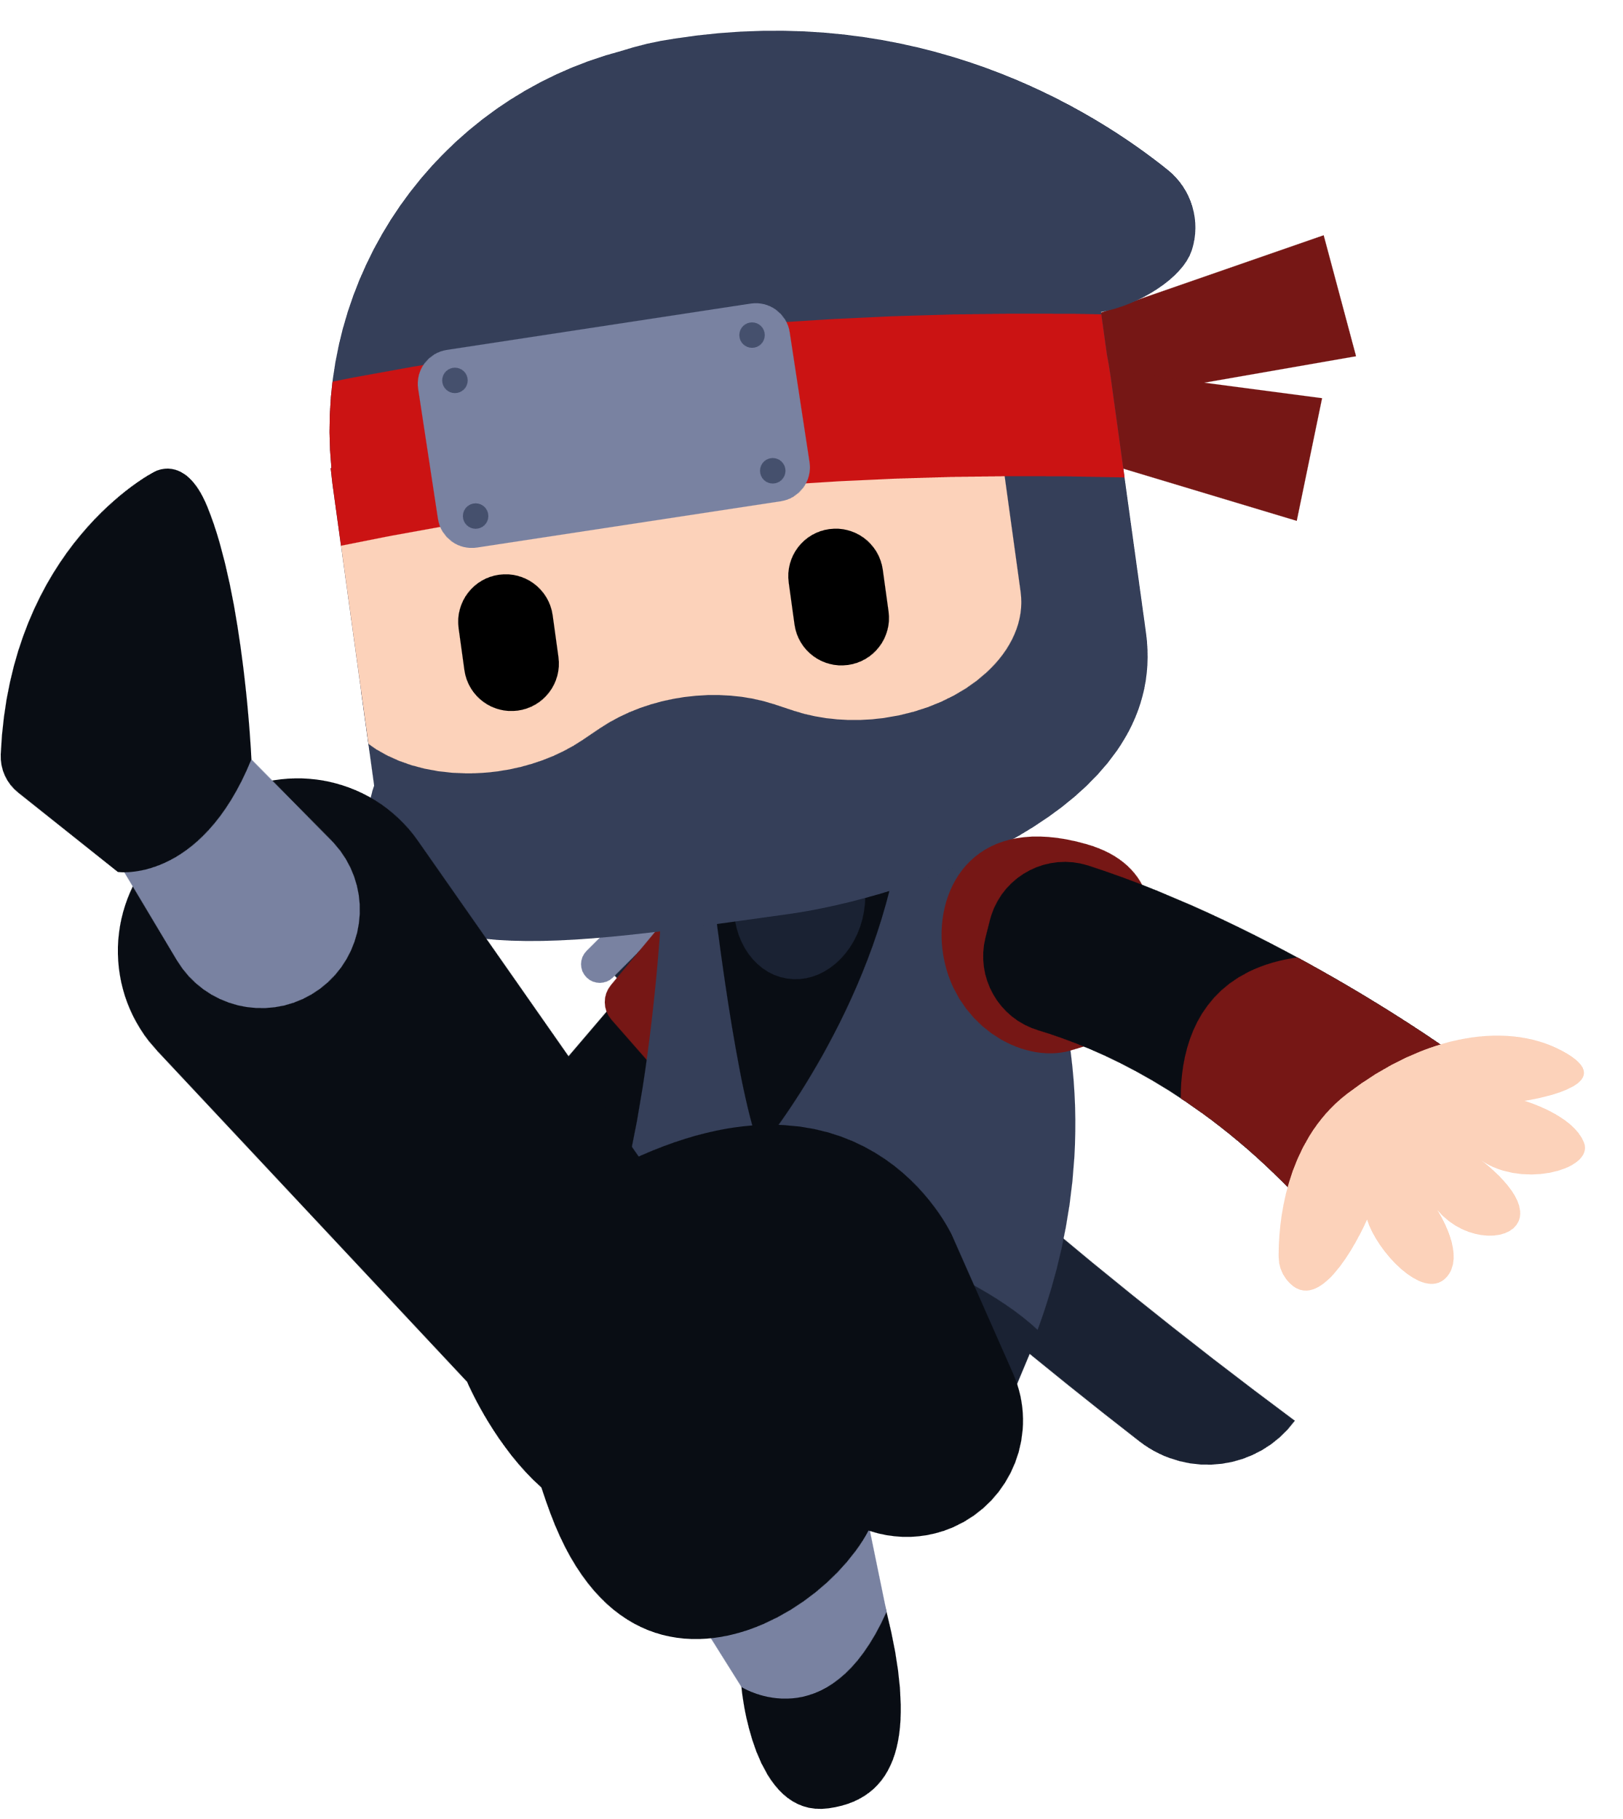
How to play
Student B will answer:
A. There is a _________.

Slide 7

How to play
Student A: “What’s in the kitchen?”
Student B: “There is a stove.”

Slide 8

How to play
Cross out the ninja in that spot.

Slide 9
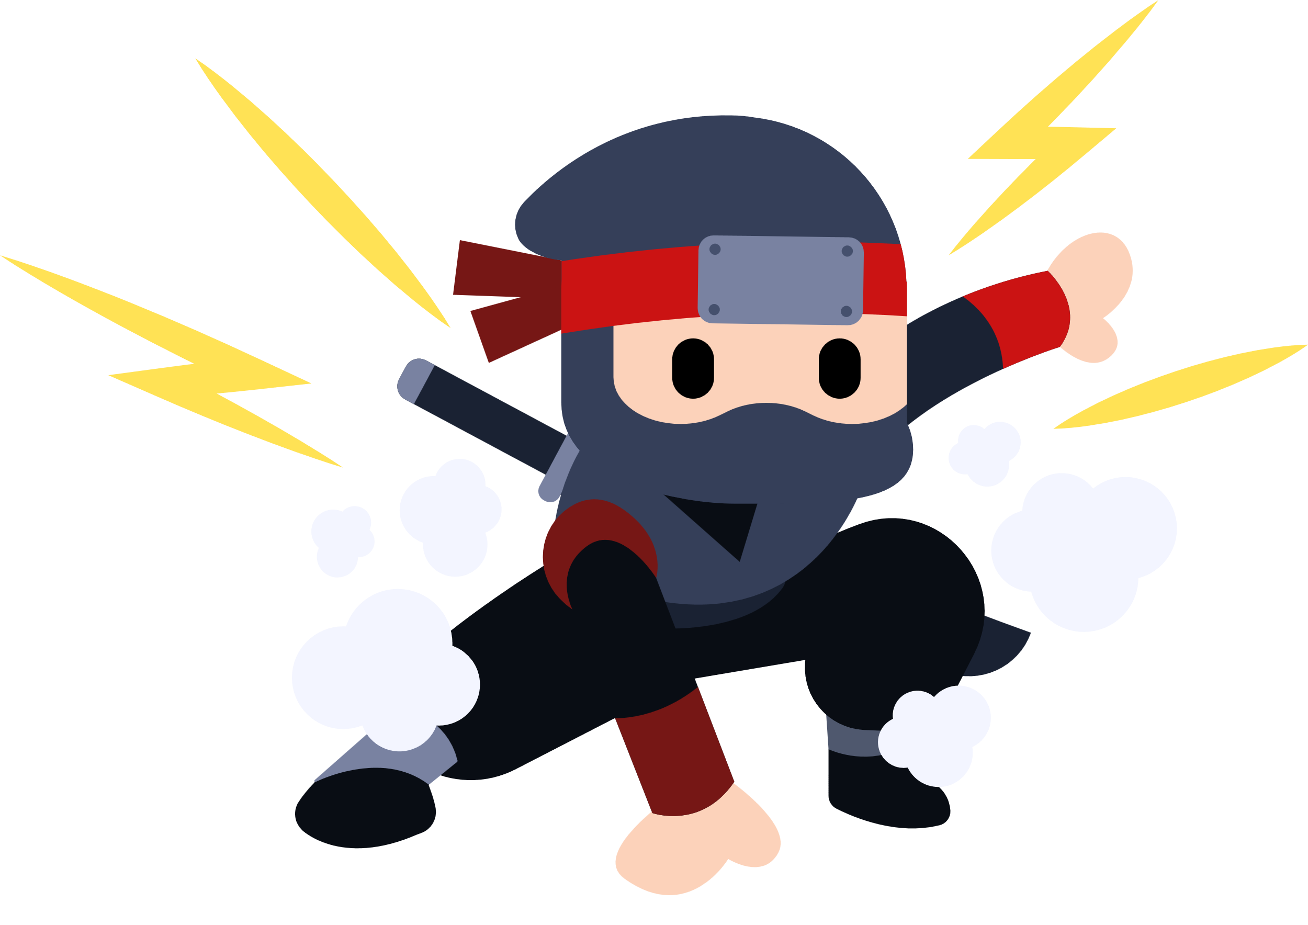
How to play
The person with the most ninjas alive at the end wins!

Slide 10
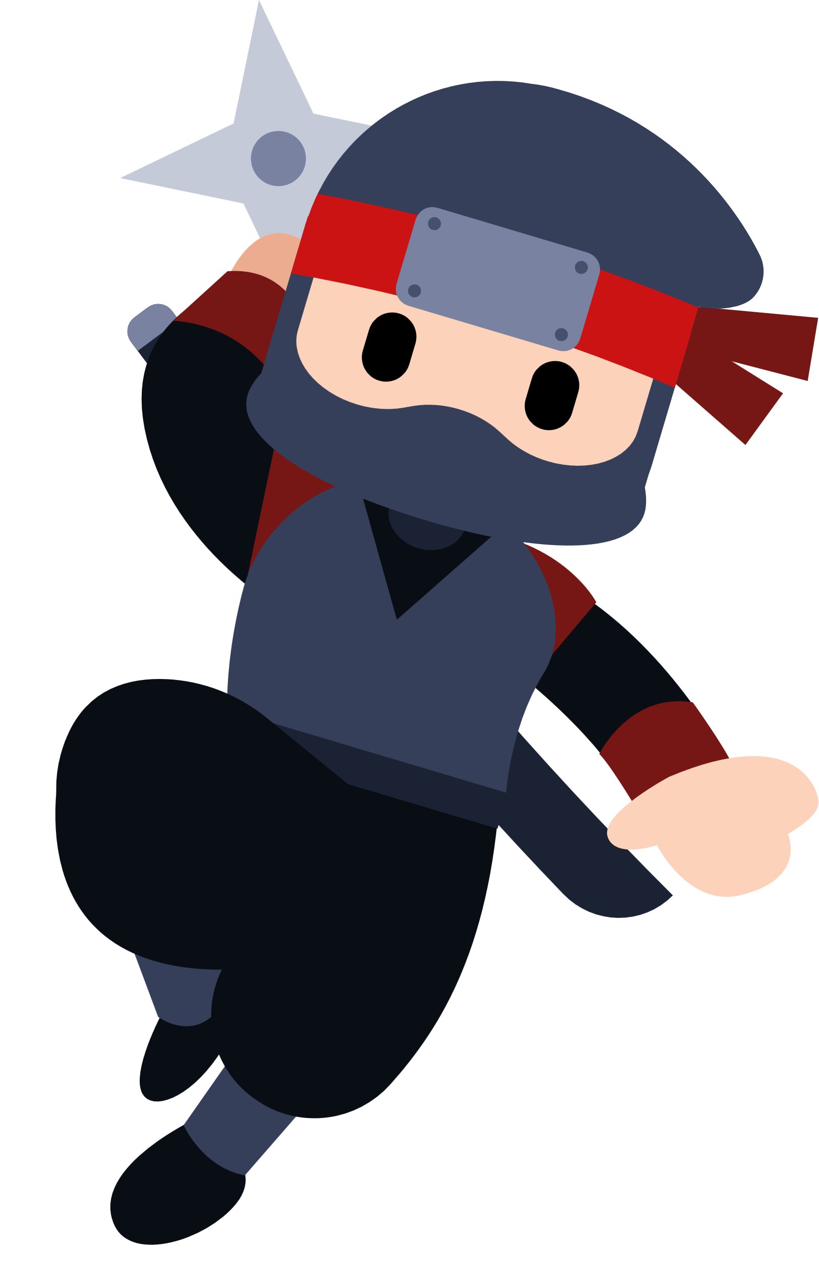
Let’s play!

Slide 11
Part 2
Play against the teacher!

Slide 12

How to play
This time, the teacher will also play.

Slide 13
How to play
If you have more ninjas alive at the end of the game than the teacher, you win!

Slide 14
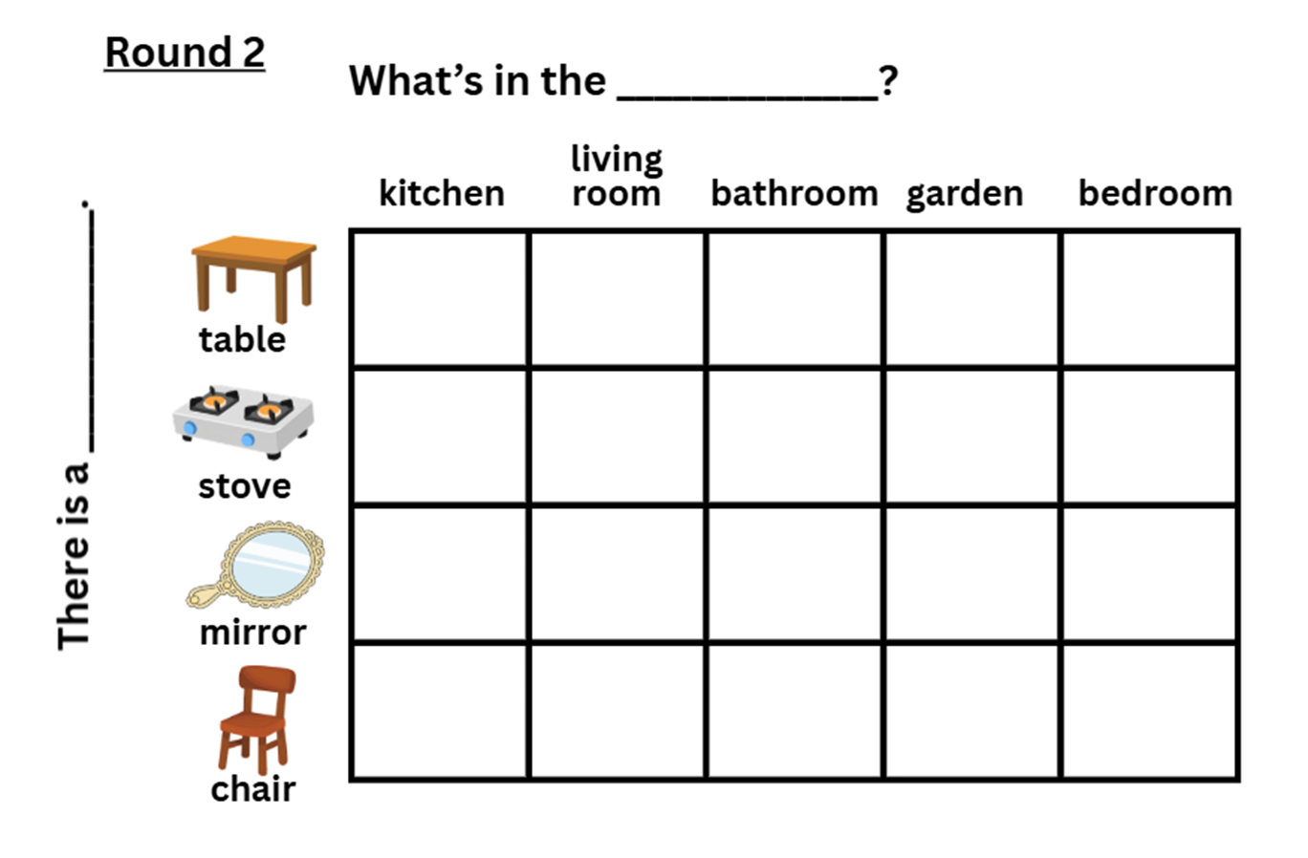
Draw 8 ninjas!

Slide 15
Nice job!

