Slide 1
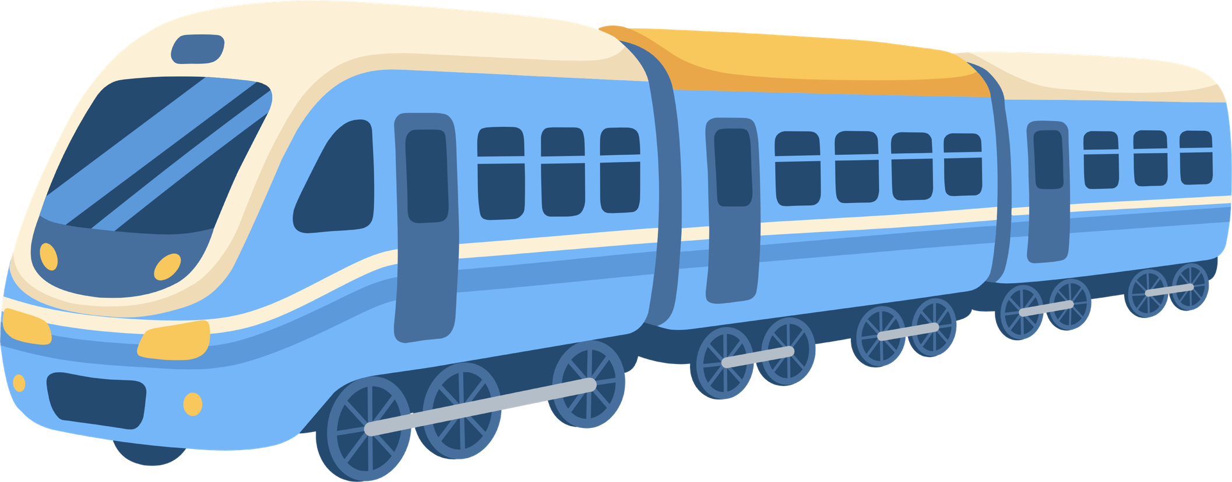
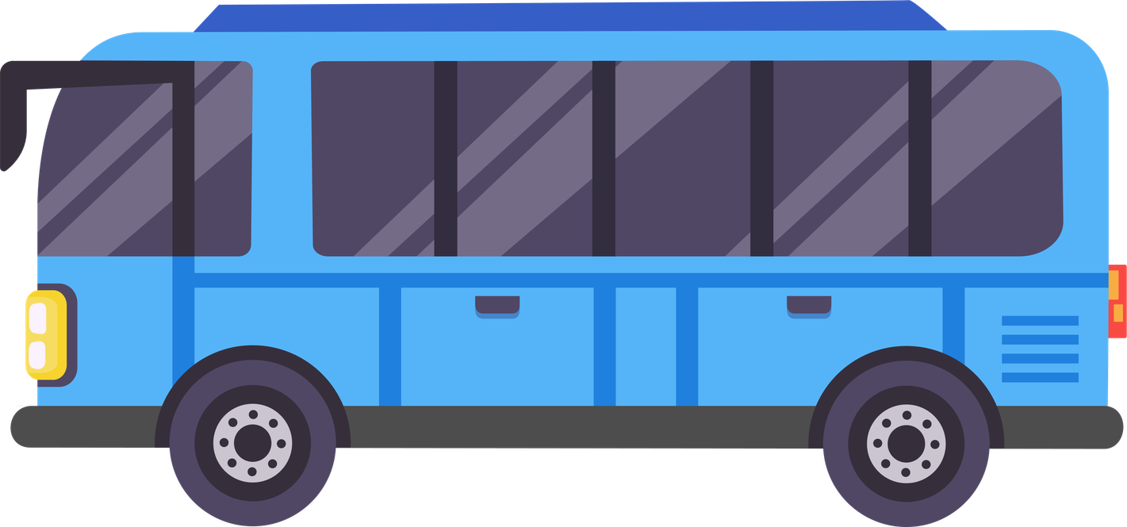
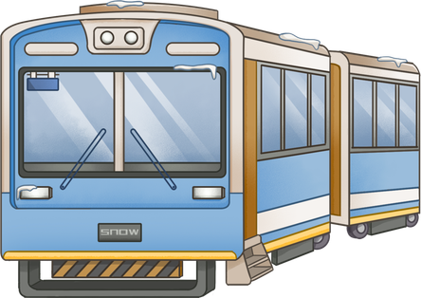
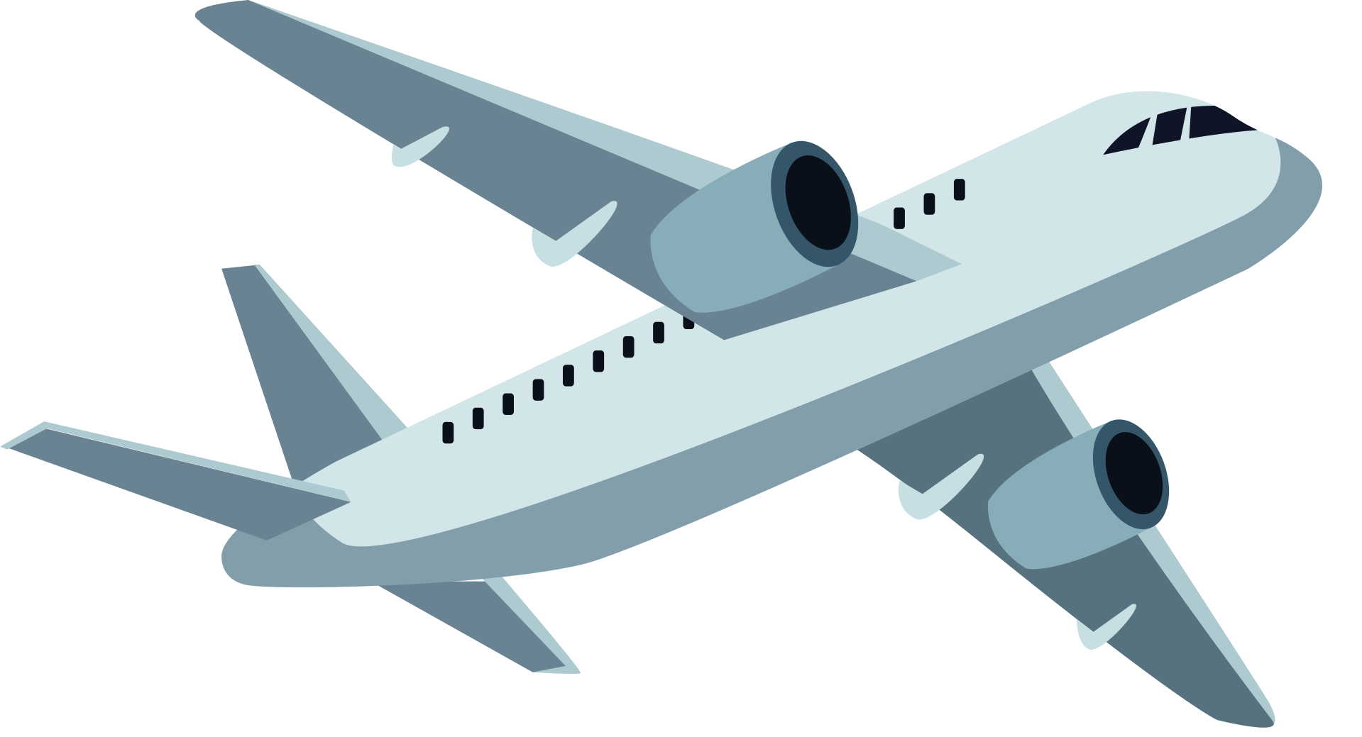
Round 1
Round 1
How can I get to (the) ______________?
How can I get to (the) ______________?
police station
museum
police station
hospital
Busan
Jeju-do
museum
hospital
Busan
Jeju-do
train
train
bus
You can get there by_____________.
You can get there by_____________.
bus
subway
subway
airplane
airplane
Round 2
How can I get to (the) ______________?
Round 2
How can I get to (the) ______________?
museum
police station
hospital
Busan
Jeju-do
museum
police station
hospital
Busan
Jeju-do
train
train
You can get there by_____________.
You can get there by_____________.
bus
bus
subway
subway
airplane
airplane

Slide 2
Round 1
Round 1
How can I get to (the) ______________?
How can I get to (the) ______________?
police station
museum
police station
hospital
library
Jeju-do
museum
hospital
library
Jeju-do
train
train
bus
You can get there by_____________.
You can get there by_____________.
bus
subway
subway
airplane
airplane
Round 2
How can I get to (the) ______________?
Round 2
How can I get to (the) ______________?
museum
police station
hospital
library
Jeju-do
museum
police station
hospital
library
Jeju-do
train
train
You can get there by_____________.
You can get there by_____________.
bus
bus
subway
subway
airplane
airplane

