Slide 1
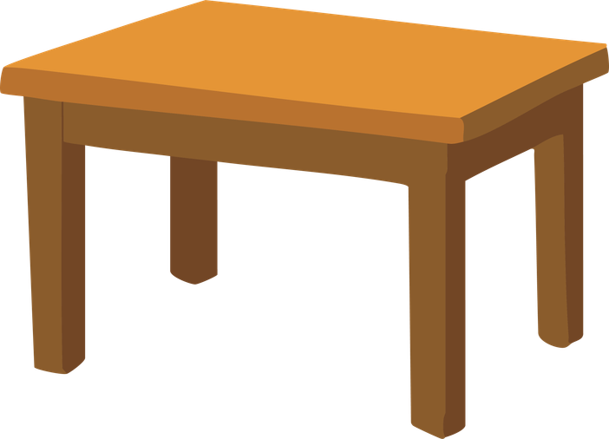
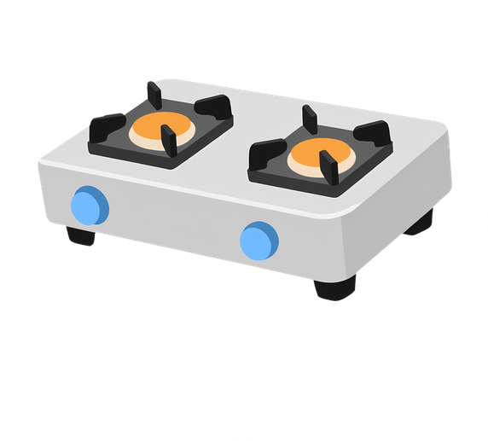


Round 1
Round 1
What’s in the ______________?
What’s in the ______________?
kitchen
living room
bathroom
garden
bedroom
kitchen
living room
bathroom
garden
bedroom
There is a _____________.
There is a _____________.
table
table
stove
stove
mirror
mirror
chair
chair
Round 2
Round 2
What’s in the ______________?
What’s in the ______________?
kitchen
living room
bathroom
garden
bedroom
kitchen
living room
bathroom
garden
bedroom
There is a _____________.
There is a _____________.
table
table
stove
stove
mirror
mirror
chair
chair

Slide 2
Round 1
Round 1
What’s in the ______________?
What’s in the ______________?
kitchen
living room
bathroom
garden
bedroom
kitchen
living room
bathroom
garden
bedroom
There is a _____________.
There is a _____________.
table
table
stove
stove
mirror
mirror
chair
chair
Round 2
Round 2
What’s in the ______________?
What’s in the ______________?
kitchen
living room
bathroom
garden
bedroom
kitchen
living room
bathroom
garden
bedroom
There is a _____________.
There is a _____________.
table
table
stove
stove
mirror
mirror
chair
chair

